Slide 1
In silico analysis of ADME/Tox profile of compounds from Croton species.
Samphelix O. Obende
Msc student from Maseno University in Kenya
Author

Slide 2
Introduction
The genus Croton contains approximately 1300 species of trees, shrubs, and herbs worldwide.
a)
b)

Slide 3
Contn
There is no ADMET properties evaluation of the compounds isolated from Croton.
Thus this work focuses on compiling latest findings from the literature on the chemical components of Croton species and their biological activities from.
Google, Google Scholar, Scopus, Science Direct, Biomed Central and PubMed.
The United States Food and Drug Administration (FDA) authorized small-molecule obtained from https://enamine.net/compound-libraries/ bioactive-libraries.
Swiss-ADME and pkCSM web server to obtain ADMET properties.
Then statistical evaluation of the virtually obtained ADME/Tox properties of these compounds from ORIGINPRO 2023 software.

Slide 4
Results and discussions
a)
Fig 1a: Phytochemicals of different classes of compounds reported from genus croton

Slide 5
b)
Fig 1b: Variation of reported biological activities from croton genus.

Slide 6
Chemical spaces Analysis using Principal Components
Figure 2: Visual representation of the chemical space of reference data sets based on 17 physicochemical and ADME/Tox descriptors. Total variance represented is 43.79% and it is an approximation of the actual property-based chemical space.
Red color -Croton compounds and black color - FDA drugs.
Notes:
seventeen physical descriptors (number of HBdon, HBacc, HA, RB, AHA, Csp3, MW, MR, TPSA, consensus log P, silicon- IT log Sw, Lipinski’s “rule of five” (Rule of Five), Egan’s rule, Ghose’s rule, Veber’s rule, Muegge’s and lead-likeness violations).
PC1 is the direction in which the data varies the most while PC2 is designed to account for the second most significant source of variability in the original dataset that was not captured by PC1.

Slide 7
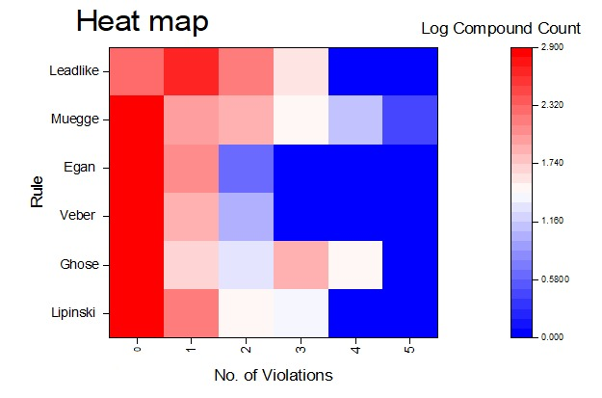
Drug-likeness and lead-like assessment
Fig 3: Heat map for the drug-like prediction based on the five rules and lead-like based on RO3. Intense red coloration indicates the high number of compounds estimated by determination of the antilog to the figures of the legend panel.

Slide 8
Pharmacokinetics (ADME) properties
a)
b)
Fig 4. ADMET properties analysis of genus croton compounds: (a) Bioavailability score, (b) Binary distribution of Pain alert, BBB permeability, P-glycoprotein (P-gp) substrate and GI-absorption predictions, (c) Binary distribution of enzyme inhibitions.
c)
Notes:
P-glycoprotein (P-gp) is a membrane protein that pumps substrates out of cells.
If a drug is a P-gp substrate, it may experience reduced absorption, leading to lower bioavailability.
High GI absorption typically leads to improved bioavailability, which is the fraction of an administered drug that reaches the systemic circulation.
High bioavailability - improved efficacy, a substantial amount of the administered drug reaches the bloodstream, achieving therapeutic concentrations thus desired pharmacological effects.

Slide 9
Toxicity prediction
Fig 5: Distribution of different toxic properties in binary form.

Slide 10
Conclusion
The major class of compound from croton are diterpenoids.
The main biological activities are cytotocxicity (52%) and anti-inflammatory activities at 13.4%.
Most of the croton compounds(76.37%) obey Rule of five.
Croton compounds share common chemical space as those of the approved FDA drugs.
ADME analysis proved only 39 compounds to be viable drug like.
Out of 39, 19 compounds were non-toxic.
Notes:
The requirements such that molecular weights are <300-500, the number of hydrogen bond donors < 3-5, the number of hydrogen bond acceptors <3-10 and Clog P <3-5, the number of rotatable bonds <3-5 and the polar surface area <60.
Further toxicity prediction of (AMES, hERG inhibition, hepatoxicity and skin sensitization)

Slide 11
Recommendation
Further docking and simulation should be done on the 19 compounds noted for their respective biological activities reported.

Slide 12
AKNOWLEGMENT
Dr. Charles O. Ochieng of Maseno University
Dr. Emmanuel A. Shikanga of Maseno University
Dr. Njogu M. Kimani of University of Embu

Slide 13
REFERENCES
Wen-Hui Xu, W.-Y. L. and Q. L. (2018). https://doi.org/10.3390/molecules23092333
Guerra Júnior, J. I.; Ferreira, M. R. A. .; Oliveira, A. M. de .; Soares, L. A. L. (2022). 2022, 1–15.
Ojuka, P., Kimani, N. M., Apollo, S., Nyariki, J., Ramos, R. S., & Santos, C. B. R. (2023). South African Journal of Botany, 157, 106–114. https://doi.org/10.1016/j.sajb.2023.03.057
Wekesa, E. N., Kimani, N. M., Kituyi, S. N., Omosa, L. K., & Santos, C. B. R. (2023). South African Journal of Botany, 162, 129–141. https://doi.org/10.1016/j.sajb.2023.09.009

Slide 14
THANK YOU

Slide 16
Screening Rules
Egan (logP ≤ 5.88, TPSA ≤ 131.6 Å²).
Lipinski rule (HBdon ≤ 5; HBacc ≤ 10; MW ≤500 Da; log P≤ 5)
Ghose rule (partition coefficient log P -0.4 and 5.6, MW 160-480, molar refractivity 40-130, and total atoms 20 and 70 including both HB donors and acceptors)
Veber’s rule (rotatable bonds ≤10 and polar surface area (TPSA) ≤ 140 Å² )
Muegges rule (MW (200-600), LogP (-2 – 5), PSA≤150, number of rings (NR)≤7, number of carbons (NC)>4, number of heteroatoms (NH)>1, RB≤15, HBD≤5, HBA≤10)
RO3 uses four parameters on a multiple of 3 as follows partition coefficient log P ≤3, MW ≤300 Daltons, HBdon ≤3, HBacc ≤3, RB ≤3

