Slide 1
Bio-inspired synthesis, characterization and biomedical applications of optimized silver nanoparticles functionalized with Ceiba pentandra (L.) Gaertn. (Kapok tree)
CAiSMD WORKSHOP
27th – 29th February 2024,
University of Buea, Cameroon
Loick Pradel Kojom Foko,^{1,2,*} Joseph Hawadak,^{1,2} Vaishali Verma,³ Philippe Belle Ebanda Kedi,⁴ Raghavendra Kamaraju,³ Veena Pande,² and Vineeta Singh^{1,*}
¹Parasite and Host Biology Group, National Institute of Malaria Research, New-Delhi, India ²Department of Biotechnology, Kumaun University, Bhimtal, India
³Vector Biology Group, National Institute of Malaria Research, New-Delhi, India
⁴Department of Pharmaceutical Sciences, The University of Douala, Douala, Cameroon
Presented by
Dr. Loick P. KOJOM FOKO, Ph.D.
ECR & Lecturer
(Biotechnology – Microbiology – Epidemiology)

Slide 2
OUTLINE
Introduction
Objectives
Materials and Methods
Results and Discussion
Conclusions
Acknowledgments

Slide 3
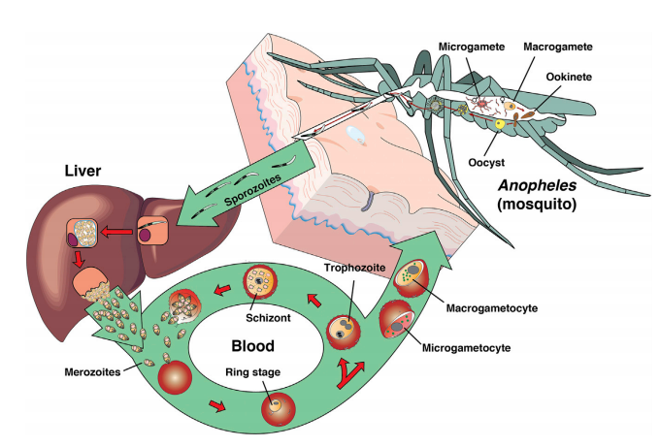
Introduction (1/4)
Malaria disease
Pathogen: Parasite protozoan (Plasmodium)
Arthropod-borne disease (Anophelinae female mosquito)
Other routes: Blood transfusion, congenital
Five human Plasmodium : P. falciparum (Pf), P. vivax (Pv), P. malariae (Pm), P. ovale spp (Po) and P. knowlesi (Pk)
Source: Davies et al., 2017,
Cowman et al., 2016
Fig. 1. Lifecycle of human Plasmodium sp parasites

Slide 4
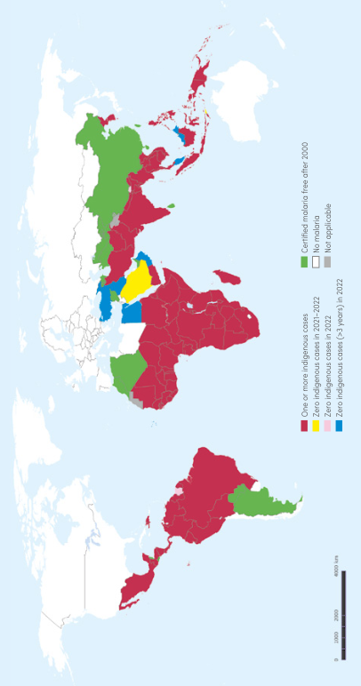
Introduction (2/4)
Malaria situation in 2022
About 249 millions cases and 608,000 deaths
Mainly due to Pf
Pv accounts for ~3% of global cases
sSA accounted for > 90% of cases and deaths
Fig. 2. Worldwide burden of malaria in 2022
Source: WHO, 2023

Slide 5
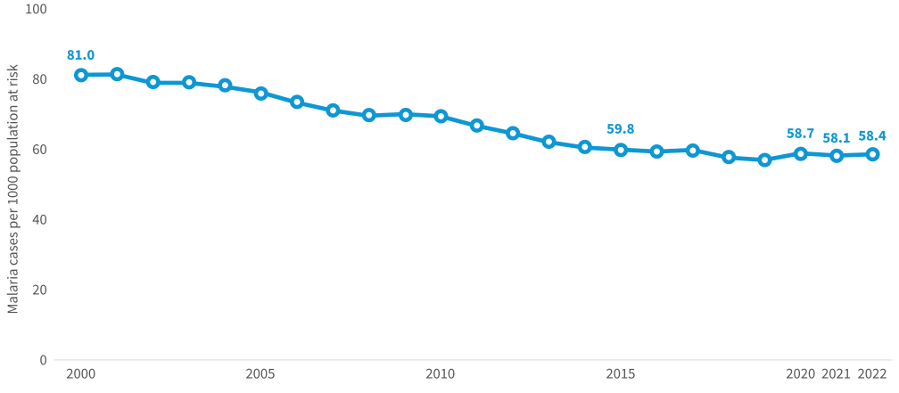
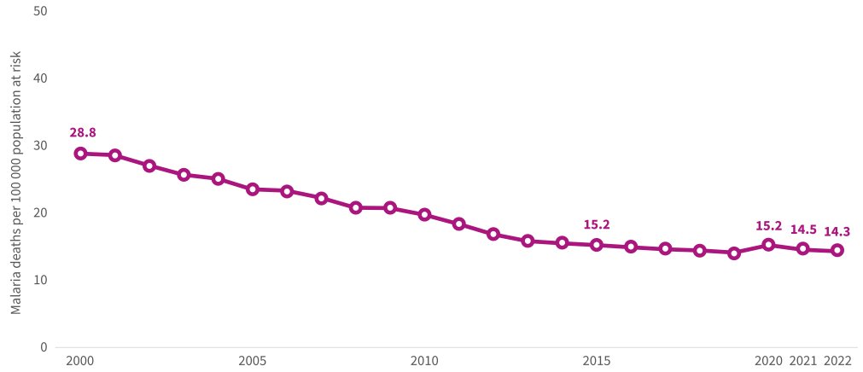
Introduction (3/4)
Fig. 3. Malaria case incidence (a) and mortality rate (b) in the WHO African Region, 2019
Large decrease in malaria morbidity and mortality these last two decades
Implementation and scale up of control measures (LLINs, IRS, RDTs, IPTp, SMC, ACTs)
Malaria still remain an important public health concern especially in Cameroon & India
Cocktail of reasons: Self-medication, asymptomatic malaria, low (very low) parasitemia, mosquito resistance, deletions in the pfhrp2 gene, COVID-19, drug resistance, etc.

Slide 6
Introduction (4/4)
Artesunate + Amodiaquine
Source: WHO, 2023
Artemether + Lumefantrine
Tafenoquine
Primaquine
ACTs
Artesunate + SP
Sulfadoxine - Pyrimethamine
Artesunate + Mefloquine
Chloroquine/
Quinine
Artesunate + Pyronaridine
Proguanil
Halofantrine
Dihydroartemisinin + Piperaquine
Emergence and spread of Pf parasites resistant to ACTs as seen recently in Africa (Rwanda, Uganda, Sudan)
Source: Uwimana et al., 2021
Balikagala et al., 2021
Fola et al., 2023
Searching and developing alternative drugs using innovative approaches

Slide 7
Objectives (1/1)
To synthesize, optimize, and characterize Ceiba pentandra-synthesized silver nanoparticles (CP-AgNPs);
To evaluate the hemocompatibility potential of CP-AgNPs;
To evaluate the antiplasmodial potential of CP-AgNPs against P. falciparum;
To evaluate the larvicidal potential of CP-AgNPs against Aedes aegypti, Culex quinquefasciatus and Anopheles stephensi.

Slide 8
MATERIALS AND METHODS

Slide 9
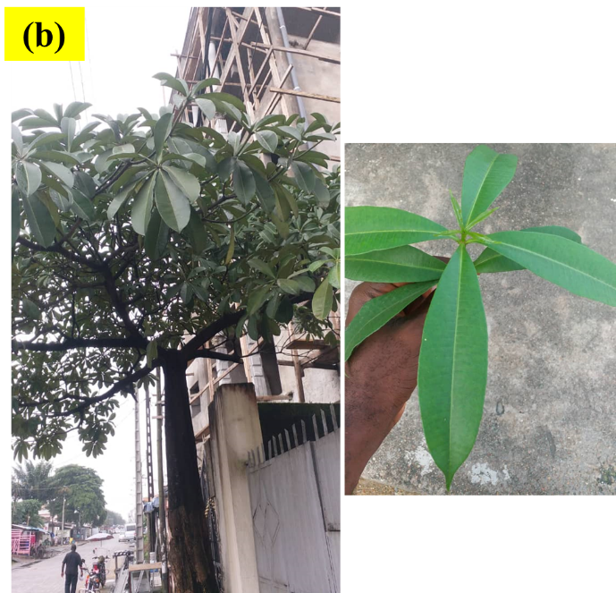
Treatment part
Materials and Methods (1/9)
Plant collection and ethnobotanical identification
Collected in Douala (Cameroon) and Identified at the National Herbarium of Cameroon
Ceiba pentandra
Malvaceae
Domesticated in Cameroon
Nutritional purposes
Skin diseases, diarrhea, bronchitis
Fig. 4. Ceiba pentandra (Plant & Leaves)

Slide 10
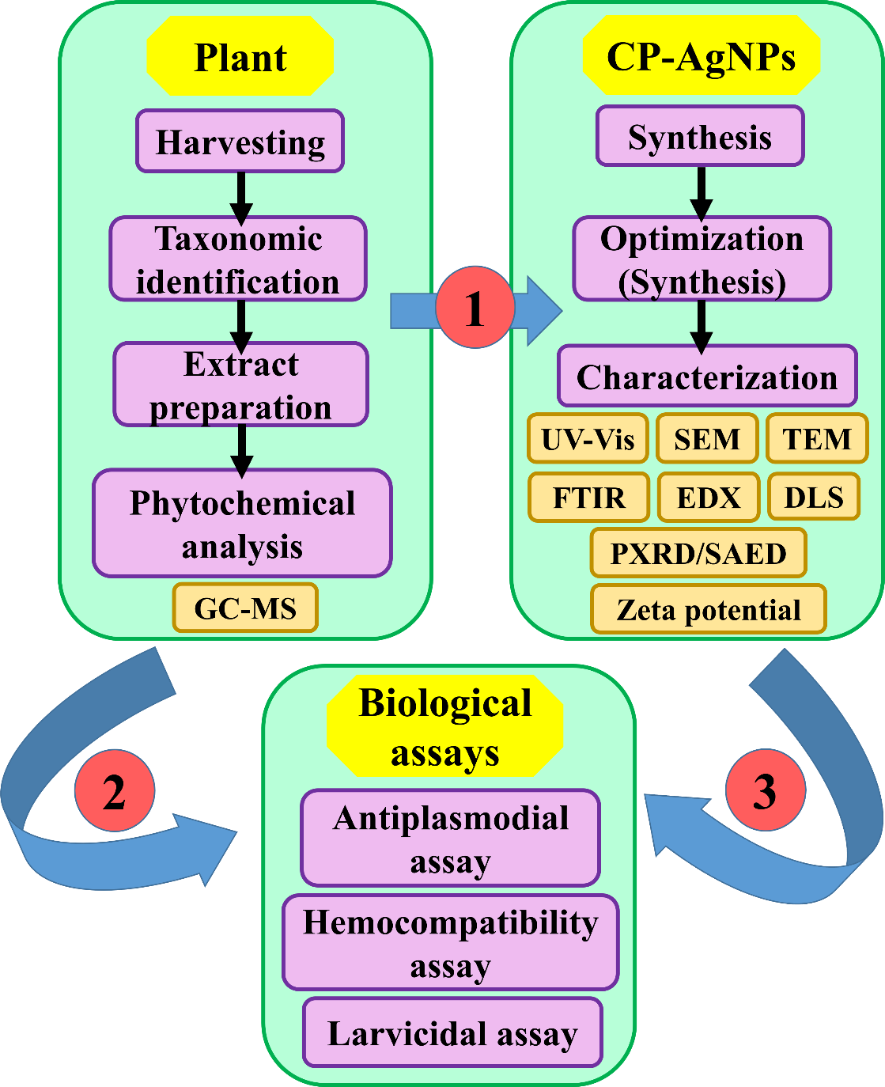
Materials and Methods (2/9)
Fig. 5. Flow diagram of the study

Slide 11
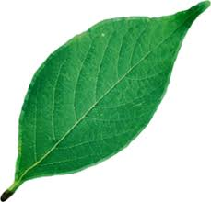
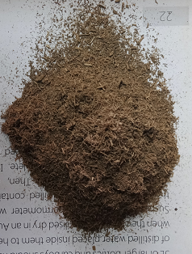
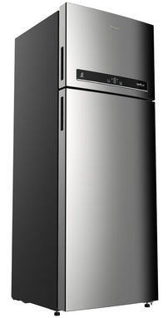
Materials and Methods (3/9)
Aqueous plant extract preparation
Washing
Cutting
Drying
Grounding
Powder
(10 g)
Distilled water
(100 mL)
Cooling at room temperature
Fresh leaves
Powder
Decoction (80°C, 5 min)
Filtration
Whatman N°1 paper
Fig. 6. Preparation of the plant extracts
Storage (4°C)

Slide 12
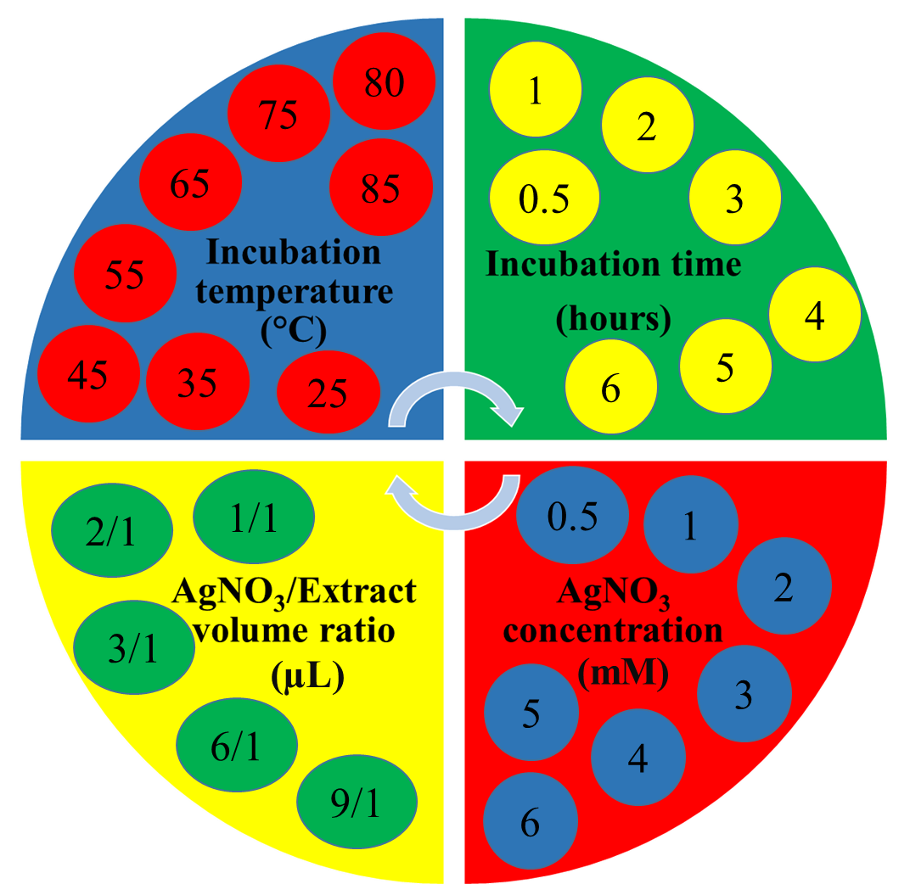
Materials and Methods (4/9)
Nanoparticle synthesis & Optimization
Plant extract
Silver nitrate
(AgNO₃)
Silver nanoparticles
Fig. 7. Synthesis and optimization of NPs

Slide 13
Materials and Methods (5/9)
Plant extract and Nanoparticle characterization
Table. 1. Methods used to characterize substances
Substances | Methods | Parameters evaluated
Extracts | Gas Chromatography + Mass spectrometry (GC-MS) | Phytochemical profile
Nanoparticles | Ultraviolet-Visible spectroscopy (UV-Vis) | Surface plasmon resonance
 | Electron microscopy (TEM & SEM) | Shape, size, size distribution
 | Energy dispersed X-ray (EDX) | Atom content
 | Fourier transformed infrared spectroscopy (FTIR) | Functional chemical groups
 | X-ray/Selected area electron diffraction (XRD/SAED) | Structure/Crystallinity
 | Zeta potential | Stability
 | Dynamic light scattering (DLS) | size, size distribution

Slide 14
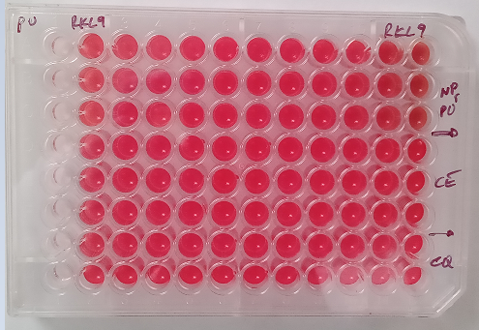
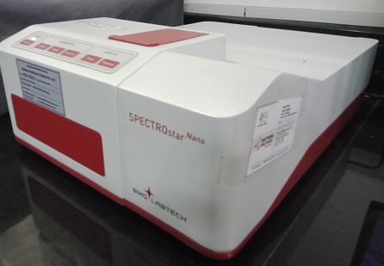
Materials and Methods (6/9)
Hemolysis assay
Fig. 8. Summary of hemolysis assay
Washing with incomplete medium
Incubation at 37°C for 30 min and 24 hrs
Dilution with PBS
180 µL
20 µL
Different substances
PBS (NC)
Saponin (PC)
AgNPs
CQ (standard drug)
Tubes – 1.5 µL
(Vt = 200 µL)
Blood
(Hct = 35%)
Blood
(Hct = 1%)
Triplicate
Source: Wang et al., 2010
Centrifugation
(3000g, 4 min)
Spectrophotometry
540 nm
100 µL
Supernatant
Transfer to 96-well plate

Slide 15
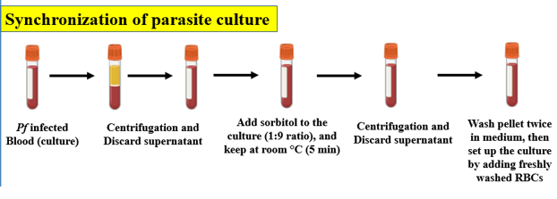
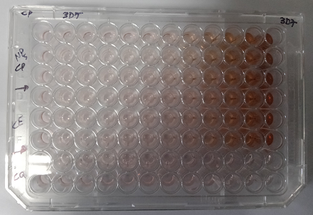
Materials and Methods (7/9)
Antiplasmodial assay
Fig. 9. Summary of antiplasmodial assay
Adding lysis buffer, 1h dark incubation, and reading
Introduction of CE, AgNPs, and CQ
Mixing up 10 µL of synchronized blood with the substances tested
Incubation at 37°C for
48 hours

Slide 16
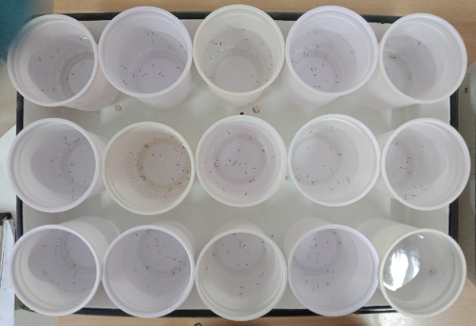
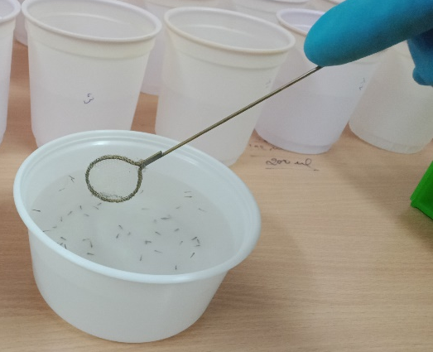
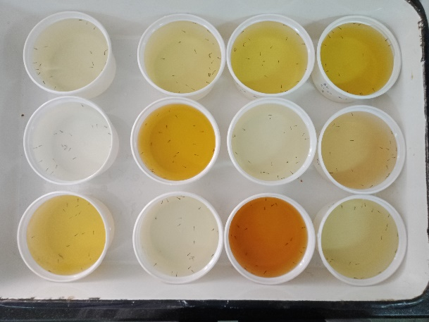
Materials and Methods (8/9)
Fig. 10. Summary of
larvicidal assay
Larvicidal assay
Mosquito rearing
Distribution of larvae
Batches of 100 eggs into 18 cm × 13 cm × 4 cm trays (500 mL of water),
Conditions: 27°C, 75–85%, and light/dark photoperiod (h/h): 14/10
Eggs were fed daily with TetraBits fish food
Instar 3rd and 4th larvae obtained were used to perform larvicidal assays.
Larvicidal effect after 24h, 48h, and 75h exposure
Introduction of NPs, Extract, Controls at different concentrations

Slide 17
Materials and Methods (9/9)
Statistical analysis
StatView v5.0, SPSS v22, and GraphPad v8.03
Qualitative variables = percentage/95%CI - Quantitative variables = mean ± SD
A probit model was used to analyze dose/time mortality response data from larvicidal assays, and determine LC₅₀ and LC₉₀ and their confidence intervals at 95% (95% CI).
The Abbott’s formula was used to correct the mortality rate if it comprised between 5% and 20% in the negative control (NC) group
One-way analysis of variance (ANOVA), Pearson’s independence chi-square, and McNemar’s tests
Statistical significance threshold of 5%

Slide 18
RESULTS AND DISCUSSION

Slide 19
Peak# | Retention time | Area% | Name of the compounds
1 | 7.39 | 0.78 | Benzene, 1,3-bis(1,1-dimethylethyl)-
2 | 8.62 | 8.12 | 2,3-Dihydro-benzofuran
3 | 10.90 | 0.45 | (Z)-1-Methyl-4-(6-methylhept-5-en-2-ylidene)cyclohex-1-ene
4 | 12.12 | 2.08 | 1,2-Benzenedicarboxylic acid, diethyl ester
5 | 12.83 | 0.56 | 2-[2-[2-(2,2,3,3,3-Pentafluoropropanoyl)oxyethoxy]ethoxy]ethyl 2,2,3,3,3-pentafluoropropanoate
6 | 13.72 | 1.47 | Trans-3(10)-caren-2-ol
7 | 14.61 | 2.71 | Neophytadiene
8 | 14.87 | 0.65 | 3H-3,10a-Methano-1,2-benzodioxocin-3-ol, octahydro-7,7-dimethyl-, (3.alpha.,6a.beta.,10a.beta.)-
9 | 15.07 | 2.07 | 2-N-Dodecylcyclohexanone
10 | 15.97 | 5.57 | Dibutyl phthalate
11 | 17.34 | 22.3 | 2-Hexadecen-1-ol, 3,7,11,15-tetramethyl-, [R-[R*,R*-(E)]]-
12 | 18.22 | 1.37 | Carbonic acid, but-3-yn-1-yl octadecyl ester
13 | 19.49 | 0.82 | 4,8,12,16-Tetramethylheptadecan-4-olide
14 | 20.94 | 3.4 | 2-Dodecylcyclobutanone
15 | 24.73 | 0.52 | .gamma.-Tocopherol
16 | 25.13 | 1.9 | 4,4,6a,6b,8a,11,11,14b-Octamethyl-1,4,4a,5,6,6a,6b,7,8,8a,9,10,11,12,12a,14,14a,14b-octadecahydro-2H-picen-3-one
17 | 25.56 | 1.7 | D:A-Friedoolean-6-ene
18 | 26.08 | 2.98 | 2H-2,4a-Ethanonaphthalen-8(5H)-one, hexahydro-2,5,5-trimethyl
19 | 26.50 | 0.78 | Ursa-9(11),12-dien-3-one
20 | 27.32 | 3.19 | .gamma.-Sitosterol
21 | 27.48 | 3.71 | 4,4,6A,6B,8A,11,11,14B-Octamethyl-1,4,4A,5,6,6A,6b,7,8,8a,9,10,11,12,12a,14,14a,14b-octadecahydro-2H-picen-3-one
22 | 27.87 | 5.57 | A'-Neogammacer-22(29)-ene
23 | 28.06 | 11.41 | Lup-20(29)-en-3-one
24 | 28.29 | 2.61 | 2-Butanone, 4-(2,2-dimethyl-6-methylenecyclohexylidene)-3-methyl-, (Z)-
25 | 28.44 | 7.61 | Lupeol
26 | 30.67 | 4.57 | Olean-12-en-28-oic acid, 2.beta.,3.beta.,23-trihydroxy-, methyl ester
27 | 33.18 | 1.11 | 9,19-Cyclo-9.beta.-lanostane-3.beta.,25-diol
Results and Discussion (1/11)
Three compounds namely
2-Hexadecen-1-ol, 3,7,11,15-tetramethyl-, [R-[R*,R*-(E)]]-,
Lup-20(29)-en-3-one,
2,3-Dihydro-benzofuran were predominantly represented at proportion of 22.3%, 11.41% and 8.12%, respectively

Slide 20
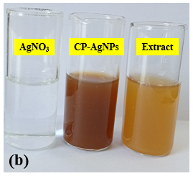
Results and Discussion (2/11)
A rapid color change (less than 10 minutes) was observed upon mixing plant extracts with AgNO₃ aqueous solution.
This change indicates the AgNPs synthesis through reduction of Ag+ ions present in solution by reducing agents contained in CEs.
Brown (CP)
Fig. 11. Color changes showing synthesis of CP-AgNPs

Slide 21
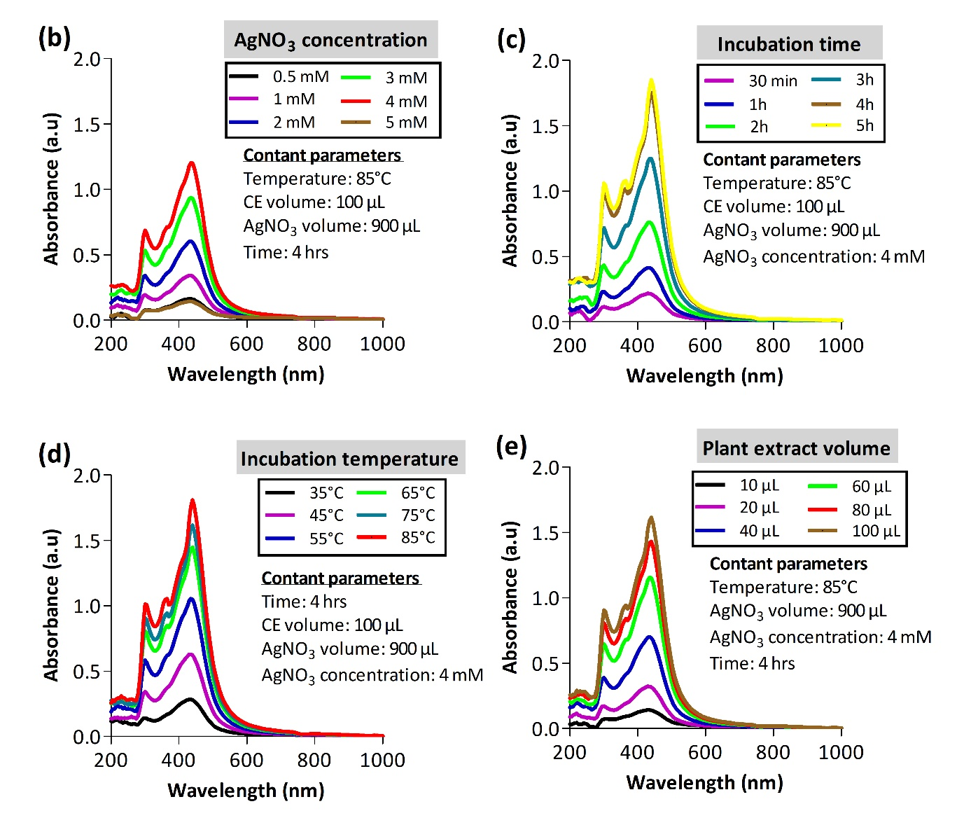
Results and Discussion (3/11)
Optimization: C. pentandra
Concentration _{(AgNO3)} = 4 mM, Incubation time = 4 hours, Incubation temperature = 85°C,
Extract plant/AgNO₃ ratio of 1: 9
Absorption peak was observed at 430 nm for CP-AgNPs.
This result translates the phenomenon of surface plasmon resonance (SPR) which occurs after bioreduction of Ag+ ions, and due to the excitation of electrons present on the NPs surface which enter into resonance with the wavelength of the incident light.
Fig. 12. Optimization of AgNPs synthesis

Slide 22
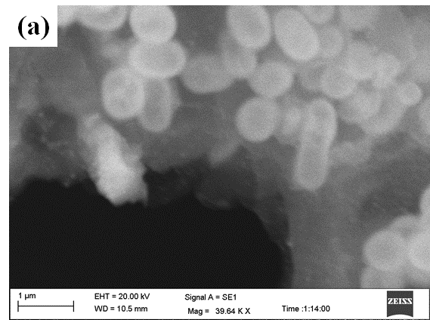
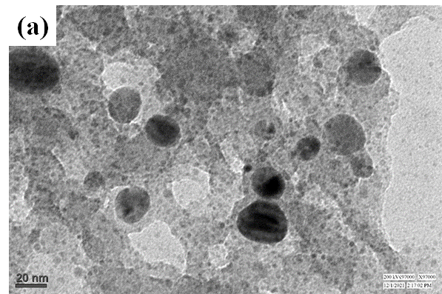
Results and Discussion (4/11)
SEM
TEM
Fig. 13. TEM and SEM analysis of CP-NPs
SEM and TEM micrographs confirmed that NPs of each plant were mainly spheroidal in shape with low polydispersity. Consistent with earlier studies with plants such as Azadirachta indica, Barletia cristata, Berberis tinctoria and Holostemma ada-kodien (Chandramohan et al., 2015; Govindarajan et al., 2016; Mahesh Kumar et al., 2016; Alyahya et al., 2018)

Slide 23
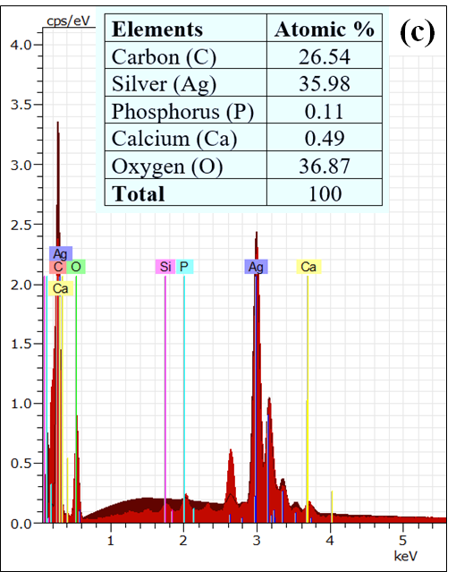
Results and Discussion (5/11)
Strong SILVER signal
Other signals (Oxygen, Cadmium, Chloride, Phosphorus, Silica, Calcium)
Presence in plant extracts as confirmed by GC-MS analysis
Source: Kojom Foko et al., 2019; 2020
Fig. 14. EDX analysis of CP-NPs

Slide 24
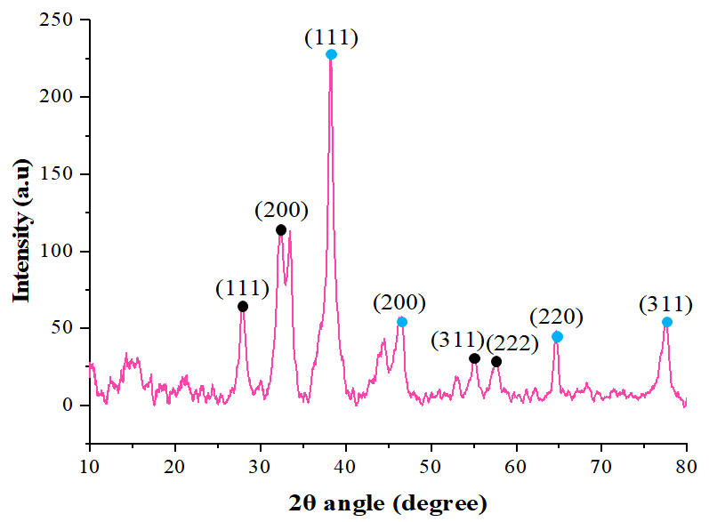
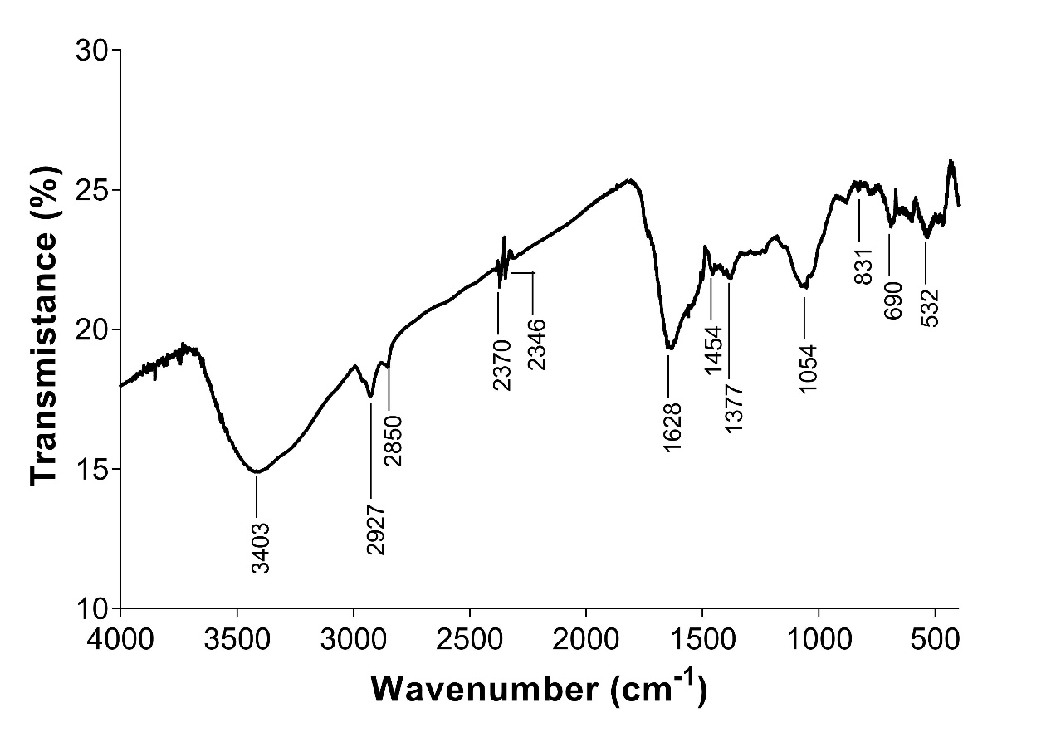
Results and Discussion (6/11)
Fig. 15. XRD and FITR of CP-NPs
Crystalline nature of NPs with a face-centered structure
peaks corresponding to the (111), (200), (220) and (311) sets of the lattice planes.
Different vibrations
3403 cm⁻¹: OH- stretch (polyphenols, polysaccharides, proteins)
1454 cm⁻¹ : C=C stretch, C-H bend (Aromatic compounds such as flavones and terpenoids)

Slide 25
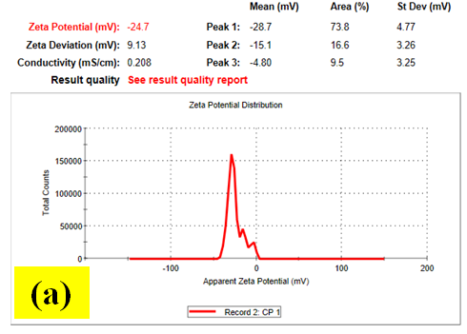
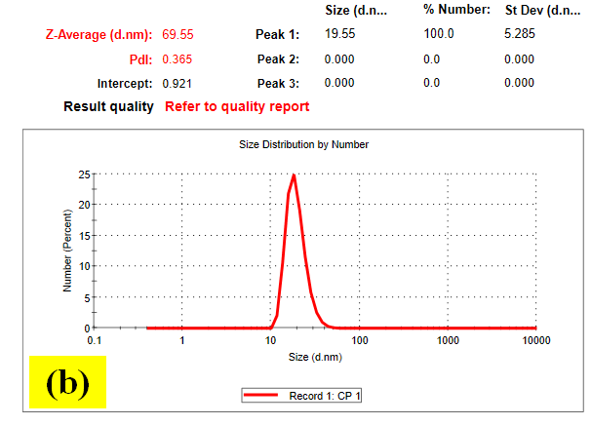
Results and Discussion (7/11)
Fig. 16. Zeta potential and DLS analysis of CP-NPs
AgNPs were highly stable and this outlines the absence of phenomena such as aggregation and flocculation which characterize an instability of NPs and can greatly influence their properties (Cui et al., 2012).

Slide 26
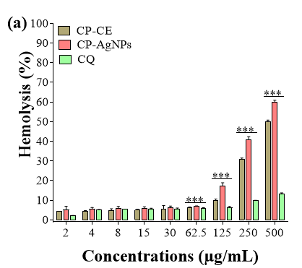
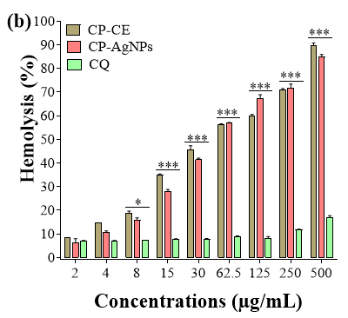
Results and Discussion (8/11)
Hemolysis rate is dose-, and time-dependent for all substances
CP-AgNPs had HC₅₀ comprised between 250 to 500 µg/mL
Fig. 17. Hemotoxic effects of AgNPs after 30 minutes (a) and 24 hours (b)

Slide 27
Results and Discussion (9/11)
Table. 2. Antiplasmodial activity of CP-AgNPs against 3D7 and RKL9
NPs more effective than CE
NPs are highly effective (IC₅₀ ≤ 20 µg/mL)
AgNPs more effective on 3D7 Compared to RKL9
Overall, our biosynthesized NPs were more effective than those reported in earlier studies (Kojom Foko et al., 2019)
A cocktail of factors (size, shape, metal source and chemical compounds) could explain these discrepancies between studies.
NPs could provoke Plasmodium death by acting on multiple targets including enzymes, cell membrane and internal organelles (Kamaraj et al., 2017; Varela Aramburu et al., 2020)

Slide 28
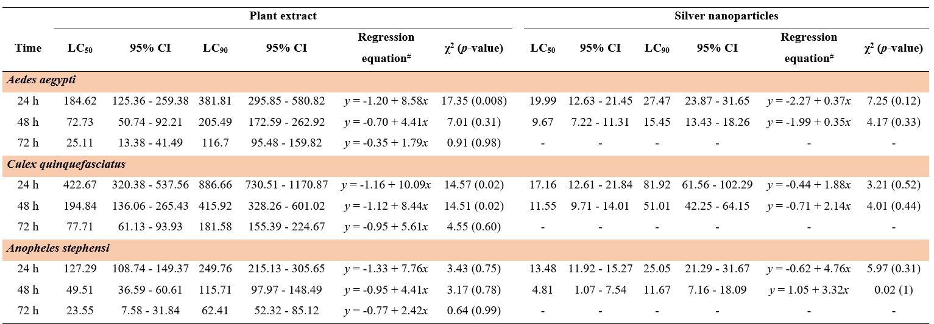
Results and Discussion (10/11)
Table. 3. Larval toxicity of the CP–CE and CP–AgNPs against mosquitoes after 24h, 48h and 72 exposure

Slide 29
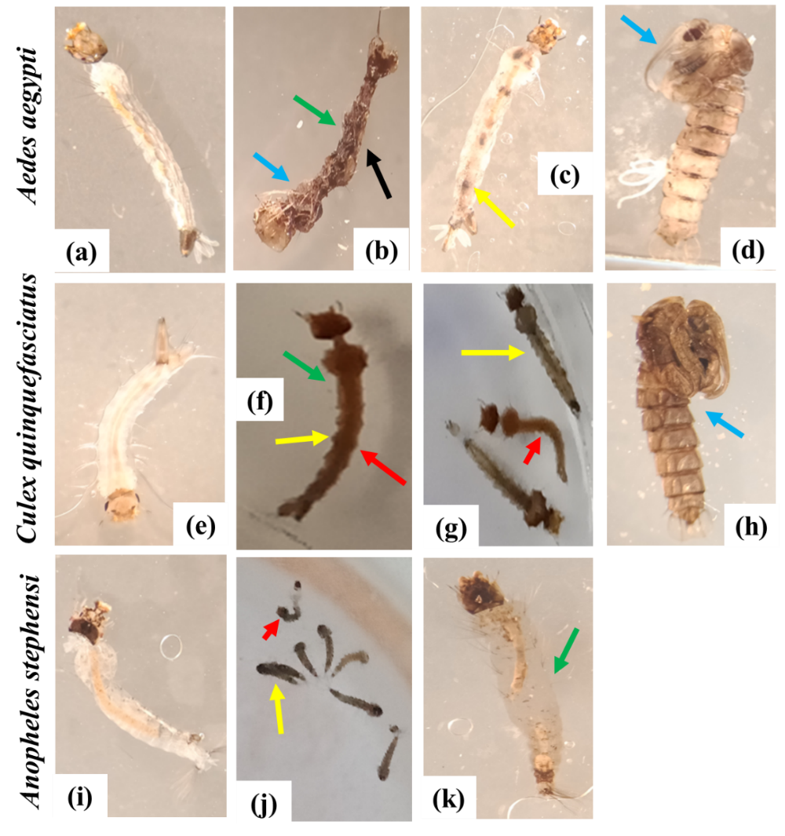
Results and Discussion (11/11)
Figure. 18. Morphological deformities induced by the exposure to CP–AgNPs (LC50 dose) on larval stages of Ae. aegypti, Cx. quinquefasciatus, and An. stephensi.
CP–AgNPs elicited a multitude of morphological changes on mosquito larvae which comprised of pigmentation of body, swelling of the apical cells, necrosis and thickening of the epidermis, loss of external hairs/bristles, and shrinkage of the larvae

Slide 30
CONCLUSIONS

Slide 31
Conclusions (1/1)
The synthesis was rapid and the biosynthesized AgNPs were polycrystalline, mostly spherical, well dispersed and stable with the role of plant compounds such as alcohols and amides as reducing and/or capping agents.
AgNPs were highly potent against Pf growth with low toxicity against RBCs thereby outlining a good hemocompatibility.
AgNPs were highly potent against mosquito larvae

Slide 32
AKNOWLEDGMENTS

Slide 33
Acknowledgments (1/2)

Slide 34
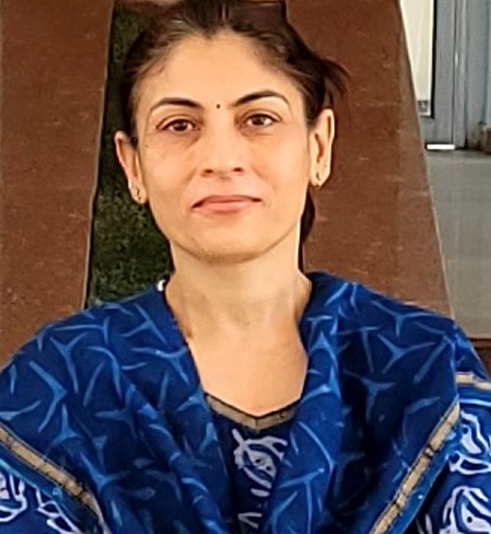
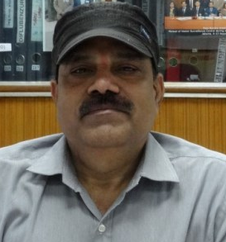
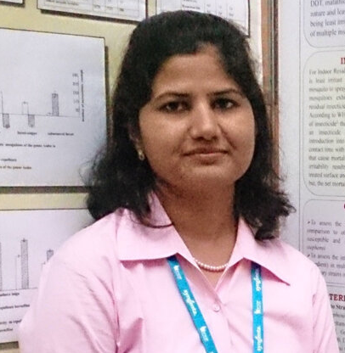
Acknowledgments (2/2)
PARASITE
VECTOR
Dr Vineeta Singh
Scientist ‘E’ & PI
Prof. Veena Pande
Full professor & PI
Dr Raghavendra Kamaraju
Former Scientist ‘G’ & PI
Dr. Philippe Belle Ebanda Kedi
Assistant lecturer
Mr. Joseph Hawadak
Senior Research Fellow
Dr Vaishali Verma
Scientist ‘C’

Slide 35
