Slide 1
BitterMasS: predicting bitterness from mass spectra
Evgenii Ziaikin
Supervisor:
Prof. Masha Niv
Notes:
Hi, my name is Evgenii Ziaikin. Today I want to present you my project BitterMasS: predicting bitterness from mass spectra

Slide 2
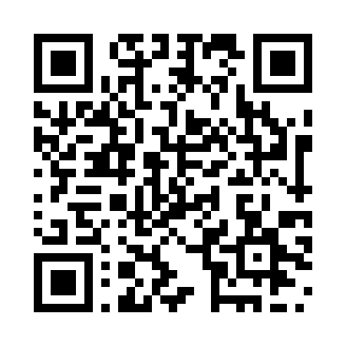
The Molecular Recognition and Chemical Senses Lab
Link to the lab
Evgenii Ziaikin
Prof. Masha Niv
Ziaikin, Camacho, Peterson, Niv, BitterMasS: predicting bitterness from mass spectra (submitted for publication)
Notes:
I am a PhD student in The Molecular Recognition and Chemical Senses Lab under the supervision of Prof. Masha Niv.

Slide 3
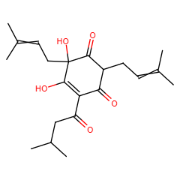
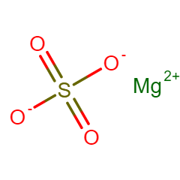
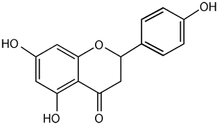
More than 1,000 compounds are known to elicit bitter taste
Including:
Salts, Peptides, Fatty acids
Polyphenols, Flavonoids
Terpenoids
Glycosides
And many more…
Dagan-Wiener A. et al. BitterDB: taste ligands and receptors database in 2019, Nucleic Acids Res., 2019
Notes:
One of the lab's projects was to create a database of compounds that cause bitterness, BitterDB. (->) It contains bitter compounds belonging to different chemical classes. (->) Including: Salts, Peptides, Fatty acids, Polyphenols, Flavonoids, Terpenoids, Glycosides, and many more

Slide 4
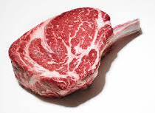
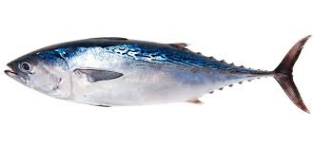
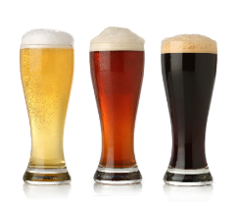
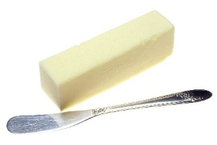
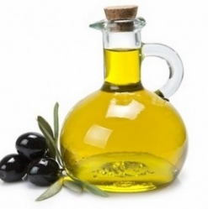
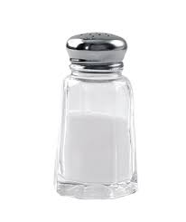
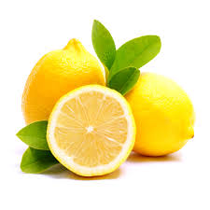
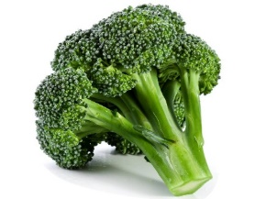
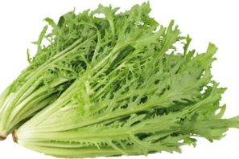
Humans can recognize 5-6 basic taste modalities
Umami
Sweet
Bitter
Fat
Many health-beneficial compounds
Salty
Sour
Notes:
Taste plays a crucial role in determining food preferences. Bitter taste is one of the six basic taste modalities that humans can sense. It is widely believed that the evolutionary purpose of bitter taste is to help animals avoid consuming toxic food. However, bitterness is not always a reliable indicator of toxicity, (->) and there is evidence that many bitter compounds have health benefits, such as antioxidant properties and anti-cancer activity. Furthermore, although bitterness can be a primary deterrent to the consumption of some foods, it is not always rejected. In fact, bitterness is often considered a desirable attribute in beverages such as coffee, beer, and wine.

Slide 5
Introduction
Which compounds are bitter?
?
?
?
Is it bitter?
Mass spectra data
Natural products
Ziaikin, Camacho, Peterson, Niv, BitterMasS: predicting bitterness from mass spectra (submitted for publication)
Notes:
Previous research conducted in the Niv lab indicated that over 77% of plant-derived products exhibit bitterness. However, 95% of the molecules found in natural products have yet to be identified, and their mass spectra have not been assigned to specific chemical structures. Our hypothesis is that these natural compounds can be classified as either bitter or non-bitter based on their mass spectra. To address this challenge, we developed the BitterMasS tool, a machine learning classifier that uses mass spectrum data to predict the probability of a compound being bitter.

Slide 6
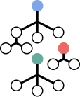
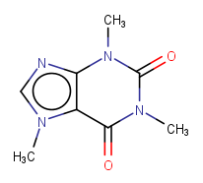
How can the bitterness of a compound be determined from its mass spectrum?
Spectra -> Bitterness
BitterMasS
What strategy is more effective?
Spectra -> Structure -> Bitterness
mass spectrum
Is it bitter?
database search
BitterPredict¹
structure
¹Dagan-Wiener A. et al. Bitter or not?
BitterPredict, a tool for predicting taste from chemical structure, Sci. Rep., 2017
Ziaikin, Camacho, Peterson, Niv, BitterMasS: predicting bitterness from mass spectra (submitted for publication)
Notes:
Bitterness can be predicted from the mass spectrum in two ways. (->) The first way is to compare the experimental mass spectrum with reference mass spectra by searching the database to annotate the chemical structure of the compound. The prediction of bitterness is then performed using the machine learning tool BitterPredict developed earlier in the Niv lab. This tool predicts the bitterness of a compound based on its structure (->) The second method is to predict bitterness directly from the mass spectrum without intermediate annotation of the chemical structure of the compound. This study aimed to determine the most effective strategy.

Slide 7
Mass spectrometry
Mass spectrometry is a technique to study the weight and identity of molecules in a sample
Sample Preparation: Convert the sample into ions
+
+
+
+
+
Ion Separation: Sort ions based on their weight-to-charge ratio
+
+
+
+
Ion Detection: Measure the abundance of different ions
Spectrum Analysis: Analyze the results to determine molecular composition
Ziaikin, Camacho, Peterson, Niv, BitterMasS: predicting bitterness from mass spectra (submitted for publication)
Notes:
Mass spectrometry is a scientific technique used to determine the weight and identity of molecules in a sample. (->) The process involves preparing a sample (->) and converting it into ions, (->) which are then sorted based on their mass-to-charge (or m/z) ratio inside a mass spectrometer. (->) The resulting spectrum shows the distribution of different ions and reveals the composition and structure of molecules in the sample.

Slide 8
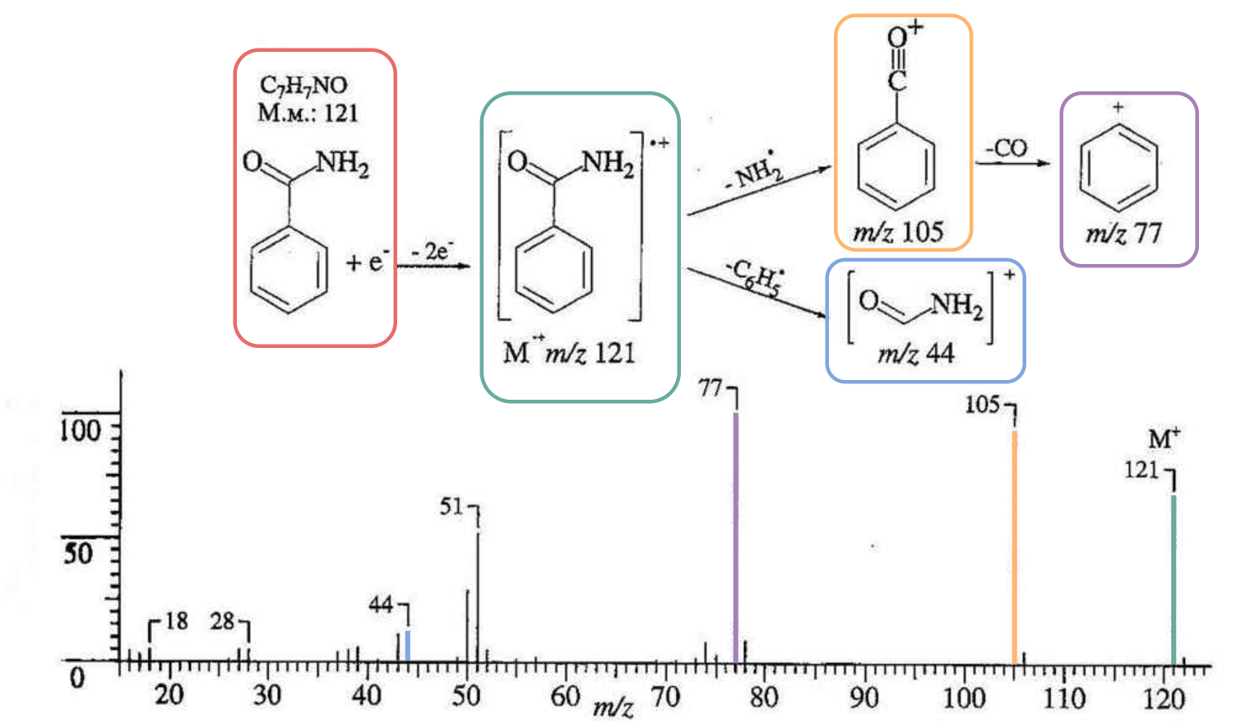
Mass spectrum
Notes:
This is an example of how the Benzamide molecule ionizes and breaks down into smaller substructures. The resulting ions are then detected, and a plot of intensity versus m/z ratio is obtained. Each line on the graph corresponds to a particular substructure, and its height indicates the number of ions detected.

Slide 9
Data curation
Data gathering from:
BitterDB¹
BitterPredict²
BitterIntense³
TAS2R14 papers^{4,5}
Obtaining
mass spectra
3577 spectra for 348 bitter compounds
and
1837 spectra for 512 non-bitter compounds
Final set
MassBank⁶
¹Dagan-Wiener A. et al. BitterDB: taste ligands and receptors database in 2019, Nucleic Acids Res., 2019
²Dagan-Wiener A. et al. Bitter or not? BitterPredict, a tool for predicting taste from chemical structure, Sci. Rep., 2017
³Margulis E. et al. Intense Bitterness of Molecules: Machine Learning for Expediting Drug Discovery, Comput. Struct. Biotechnol. J., 2021
⁴Fierro F. et al. Inhibiting a promiscuous GPCR: iterative discovery of bitter taste receptor ligands, Cell. Mol. Life Sci., 2023
⁵Waterloo L. et al. Discovery of 2-Aminopyrimidines as Potent Agonists for the Bitter Taste Receptor TAS2R14, J. Med. Chem., 2023
⁶MassBank: Release version 2021.12
Ziaikin, Camacho, Peterson, Niv, BitterMasS: predicting bitterness from mass spectra (submitted for publication)
Notes:
To obtain data for training the model, sources containing both bitter and non-bitter compounds were used. We used: BitterDB database, data used to train tools such as BitterPredict (for predicting bitterness from compound structure), BitterIntense (for predicting bitterness intensity from compound structure), and publications reporting new bitter molecules that are agonists of TAS2R14, one of the 25 functional bitter receptors found in humans. (->) Mass spectra for the prepared compound set were then extracted from the MassBank database (->) The final set contained 3577 mass spectra for 348 bitter compounds and 1837 spectra for 512 non-bitter compounds.

Slide 10
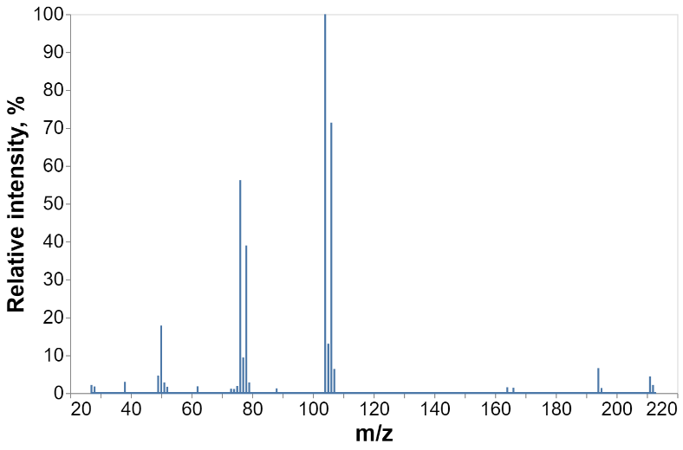
Generation of descriptors
instrument descriptors
peak descriptors
1 | 1 | 45
0 | 20 | … | 0 | 60 | 40 | … | 10 | 0
MS type
ionization energy
Each bit is equal to a relative intensity value at the corresponding m/z interval
ionization type
Ziaikin, Camacho, Peterson, Niv, BitterMasS: predicting bitterness from mass spectra (submitted for publication)
Notes:
Both instrumental and peak features were used to generate descriptors. (->) The instrumental descriptors included information such as the type of mass spectrum, ionization, and ionization energy at which the spectrum was obtained. (->) A binning strategy was used for the peak descriptors, dividing the entire range of m/z values into small bins of size 0.1 and recording the peaks that fell into the corresponding bin. These two types of descriptors were then combined and used for model training.

Slide 11
Model training and validation
Repeating 20 times
random forest
training set (80%)
5-fold
cross-validation
model training
Split is made by compounds
dataset
validation
test set (20%)
hyperparameters optimization
Ziaikin, Camacho, Peterson, Niv, BitterMasS: predicting bitterness from mass spectra (submitted for publication)
Notes:
The training and testing process followed a standard procedure. (->) Firstly, the prepared set of spectra was split into train and test sets based on compounds, ensuring that spectra for the same compound were not separated. (->) Next, the model was trained using the train set, followed by a cycle of 5-fold cross-validation and hyperparameter optimization to improve its performance. (->) Finally, the model was validated on the test set. This procedure was repeated 20 times with random separations.

Slide 12
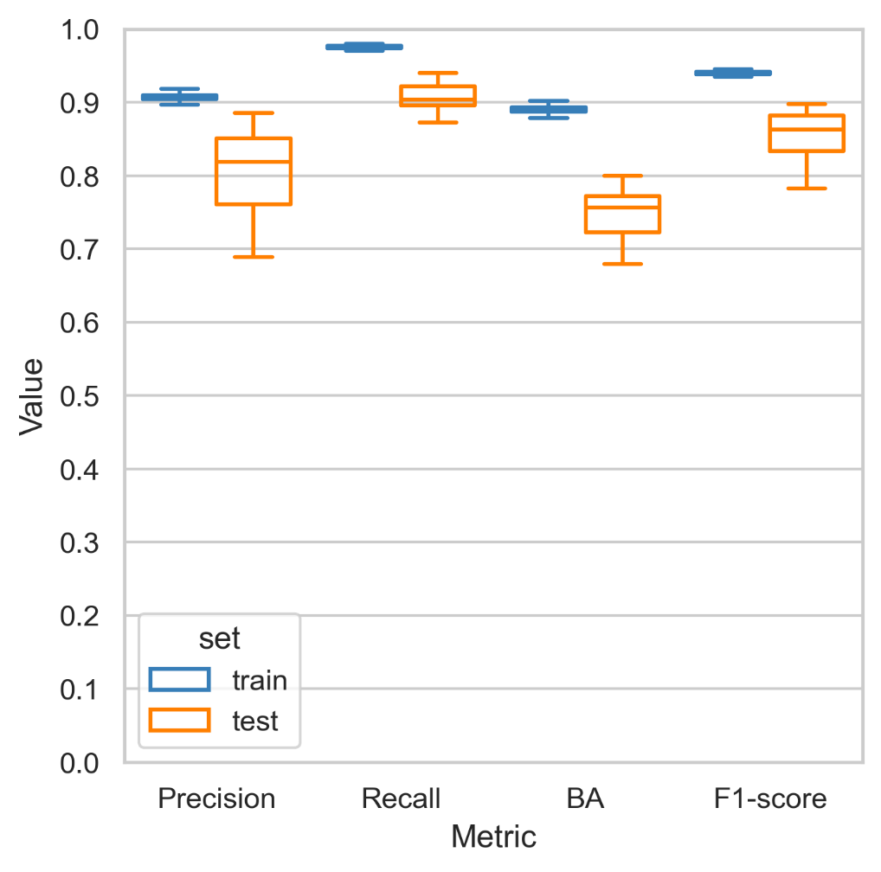
20 random splitting, training and validation results
Set | Precision | Recall | BA | F1-score
Training | 0.91±0.01 | 0.98±0.01 | 0.90±0.01 | 0.94±0.01
Test | 0.83±0.06 | 0.90±0.03 | 0.78±0.05 | 0.86±0.04
The best model was selected based on the highest BA value on the test set
Ziaikin, Camacho, Peterson, Niv, BitterMasS: predicting bitterness from mass spectra (submitted for publication)
Notes:
Based on the results obtained, all models performed similarly on the training set across all metrics. The variation in performance on the test set can be attributed to the success of the splits. However, for the test set, the metrics have good values. Subsequently, the best model with the highest balanced accuracy on the test set was selected.

Slide 13
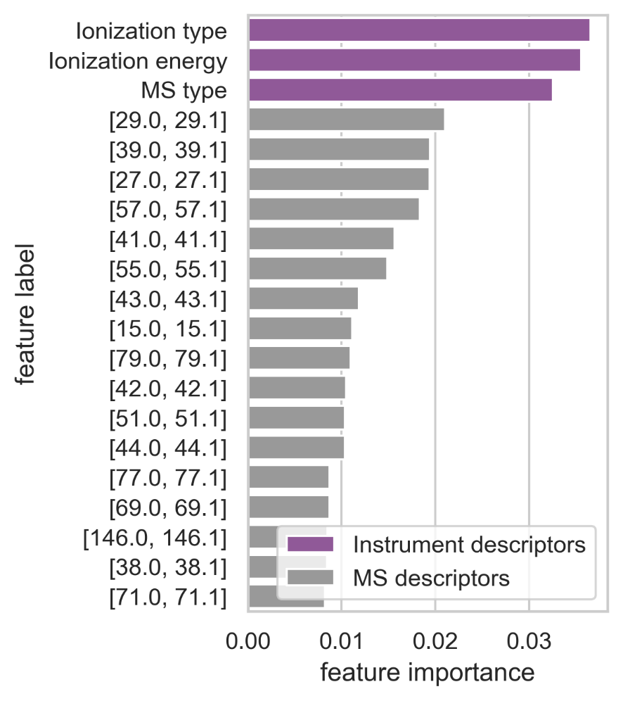
Base model feature importance
Top 20 features
total importance: 10%
total importance: 90%
Square brackets indicate the intervals of m/z values that fall into the bin
Ziaikin, Camacho, Peterson, Niv, BitterMasS: predicting bitterness from mass spectra (submitted for publication)
Notes:
The analysis of the importance of features in the descriptors revealed that the instrumental descriptors were the three most important, despite only representing 10% of the total importance of all descriptors. The peak descriptors, on the other hand, had a combined importance of 90%, which was evenly distributed across each bin, indicating that all bins were significant. Therefore, the model primarily uses peak descriptors.

Slide 14
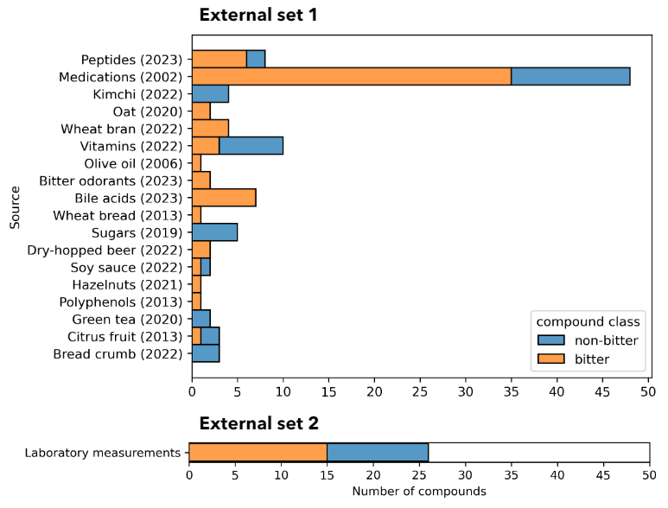
External sets
*
*Prof. Devin G Peterson, Ohio State University
Ziaikin, Camacho, Peterson, Niv, BitterMasS: predicting bitterness from mass spectra (submitted for publication)
Notes:
Two external sets were trained to further validate the BitterMasS model. These are the more difficult models to predict. Orange indicates bitter compounds and blue indicates non-bitter compounds. The first external set was assembled based on several publications that investigated natural or other products using mass spectrometry in combination with sensory testing. The second set was based on laboratory measurements carried out by the laboratory of our collaborator Prof. Devin Peterson at Ohio State University.

Slide 15
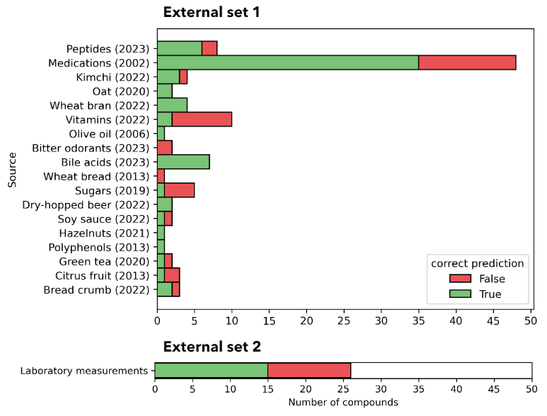
External set predictions
Set | # compounds | # mass spectra | Precision | Recall | BA | F1-score
External set 1 | 106 | 759 | 0.67 | 0.93 | 0.57 | 0.78
External set 2 | 26 | 111 | 0.58 | 0.99 | 0.50 | 0.73
*
*Prof. Devin G Peterson, Ohio State University
Ziaikin, Camacho, Peterson, Niv, BitterMasS: predicting bitterness from mass spectra (submitted for publication)
Notes:
Based on the results, the model performance is higher for the first outer set. The correct predictions of the model are shown in green and the incorrect ones in red. For some individual categories, such as vitamins or sugars, the model has low performance because there are not enough representatives of this class in the training set, which will be corrected in the future.

Slide 16
How can the bitterness of a compound be determined from its mass spectrum?
Spectra -> Bitterness
Strategy | # compounds | Precision | Recall | BA | F1-score
Spectra -> Bitterness | 130 | 0.66 | 0.93 | 0.55 | 0.77
Spectra -> Structure -> Bitterness | 73 | 0.65 | 0.65 | 0.53 | 0.65
BitterMasS
Spectra -> Structure -> Bitterness
mass spectrum
Is it bitter?
database search
BitterPredict¹
structure
¹Dagan-Wiener A. et al. Bitter or not? BitterPredict, a tool for predicting taste from chemical structure, Sci. Rep., 2017
Ziaikin, Camacho, Peterson, Niv, BitterMasS: predicting bitterness from mass spectra (submitted for publication)
Notes:
The final test for BitterMasS was to examine the effectiveness of the strategy for predicting bitterness directly from the spectrum. According to the results obtained, the 'spectra to bitterness' strategy was more effective than the 'spectra to structure to bitterness' strategy for all calculated metrics. In addition, the 'spectra to bitterness' strategy is able to predict bitterness for more compounds (or their corresponding spectra) than the 'spectra to structure to bitterness' strategy, as it does not have such strict limitations in the applicability domain and does not lose efficiency in the intermediate step of compound structure annotation. This confirms the effectiveness of BitterMasS in situations where the chemical structure of the compound is unknown but mass spectral data is available.

Slide 17
Conclusions
BitterMasS developed and tested on the mass spectra of several natural sources
BitterMasS can be continuously improved by incorporating additional data
BitterMasS direct strategy can be assigned to evaluation of Mass spectra of new plants
Please contact us if interested in collaborations
masha.niv@mail.huji.ac.il
evgenii.ziaikin@mail.huji.ac.il
Ziaikin, Camacho, Peterson, Niv, BitterMasS: predicting bitterness from mass spectra (submitted for publication)

Slide 18
Thank you for your attention!
Notes:
Thank you for your attention! Ready to answer your questions

Slide 19
Data curation
BitterDB¹
BitterPredict²
BitterIntense³
TAS2R14 papers^{4,5}
MassBank⁷
Basic aminoacids⁶
Compounds
Experimental
mass spectra
Final set
1533 EI-MS spectra for
667 compounds
+
3881 ESI-MS/MS spectra for
312 compounds
1418 bitter and
1579 non-bitter compounds
5414 mass spectra in positive ion mode for 860 compounds
Ziaikin, Camacho, Peterson, Niv, BitterMasS: predicting bitterness from mass spectra (submitted for publication)

Slide 20
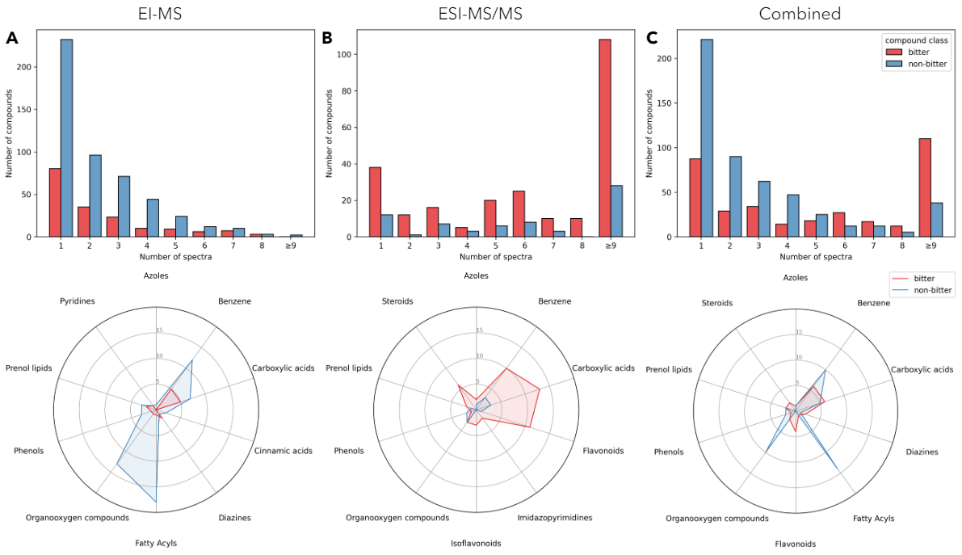
Number of spectra per compound distribution
Ziaikin, Camacho, Peterson, Niv, BitterMasS: predicting bitterness from mass spectra (submitted for publication)

Slide 21
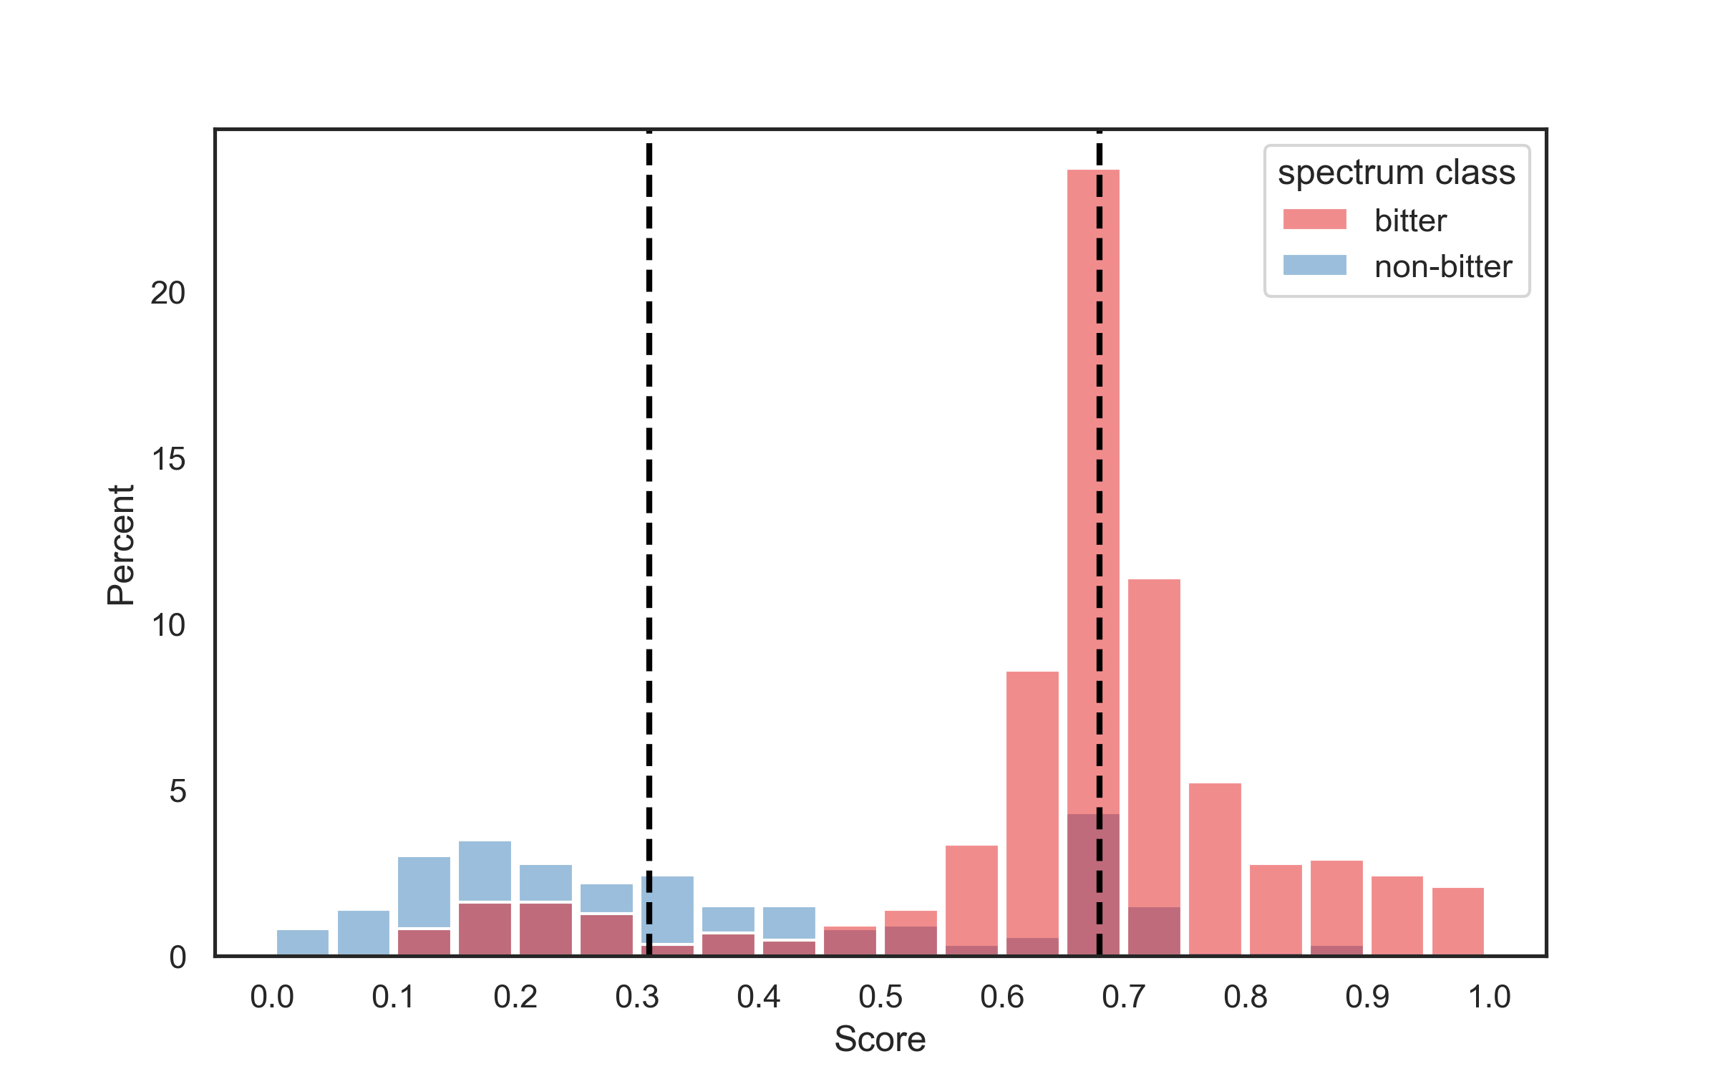
Thresholds for reliable predictions
non-bitter threshold
bitter threshold
Prediction scores greater than 0.68 lead to FPR lower than 0.05 and sensitivity above 0.5 (for bitter)
Prediction scores less than 0.31 lead to FNR lower than 0.1 and specificity above 0.5 (for non-bitter)
Ziaikin, Camacho, Peterson, Niv, BitterMasS: predicting bitterness from mass spectra (submitted for publication)

Slide 22
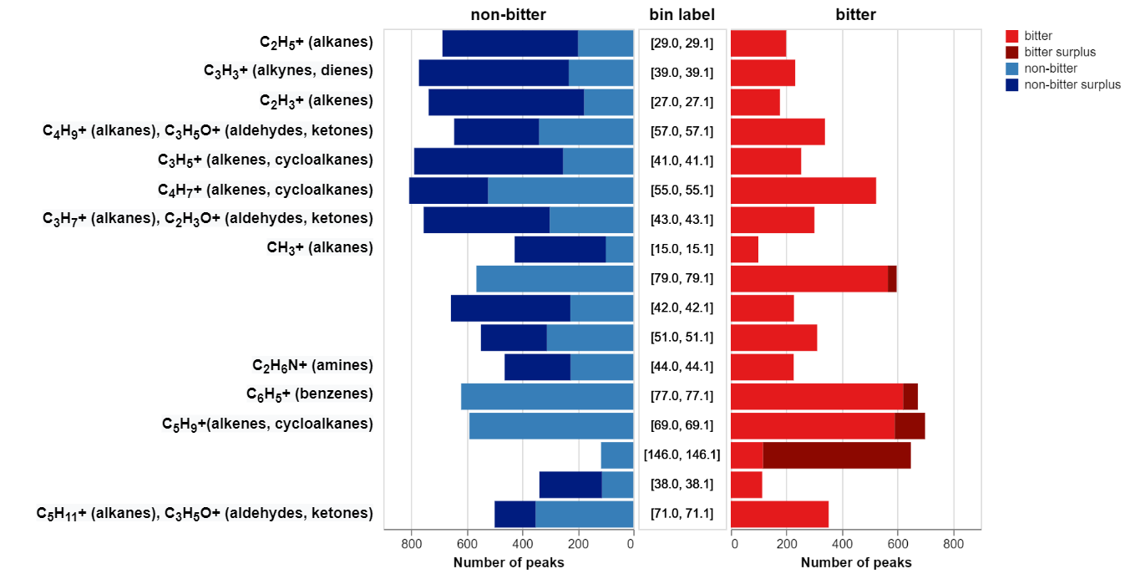
Popularity of important peaks
Ziaikin, Camacho, Peterson, Niv, BitterMasS: predicting bitterness from mass spectra (submitted for publication)

Slide 23
Which dataset and which algorithm to choose?
Dataset | Train set |  |  |  | Test set
 | Precision | Recall | BA | F1 score | Precision | Recall | BA | F1 score
Random Forest
EI-MS | 0.99 | 0.98 | 0.99 | 0.98 | 0.57 | 0.29 | 0.60 | 0.38
ESI-MS² | 1.00 | 0.80 | 0.90 | 0.89 | 0.85 | 0.63 | 0.52 | 0.72
Combined | 0.91 | 0.98 | 0.90 | 0.94 | 0.82 | 0.92 | 0.73 | 0.87
XGBoost
EI-MS | 0.99 | 0.74 | 0.87 | 0.85 | 0.52 | 0.33 | 0.60 | 0.41
ESI-MS² | 0.88 | 1.00 | 0.71 | 0.93 | 0.85 | 1.00 | 0.52 | 0.92
Combined | 0.89 | 0.94 | 0.86 | 0.92 | 0.82 | 0.91 | 0.72 | 0.86
Ziaikin, Camacho, Peterson, Niv, BitterMasS: predicting bitterness from mass spectra (submitted for publication)

Slide 24
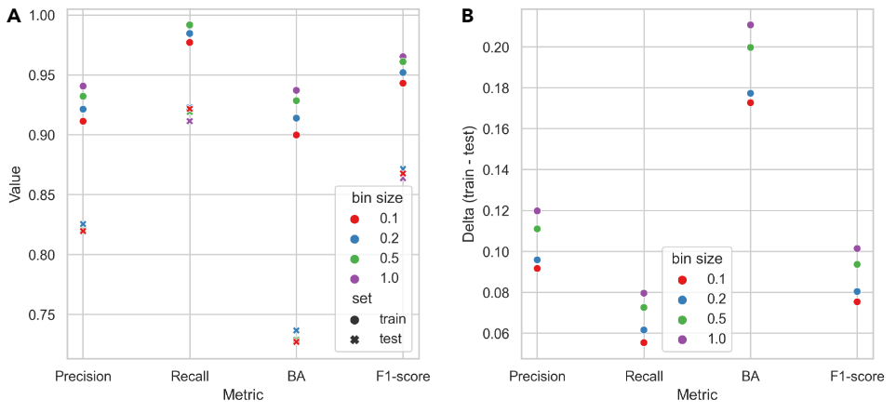
Which bin size to choose?
Ziaikin, Camacho, Peterson, Niv, BitterMasS: predicting bitterness from mass spectra (submitted for publication)

Slide 25
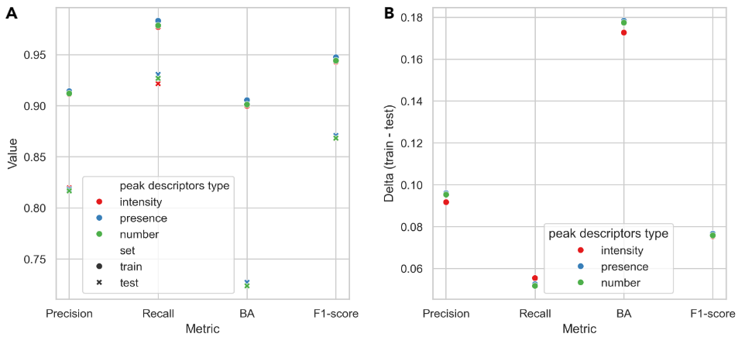
Which peak descriptors type to choose?
Ziaikin, Camacho, Peterson, Niv, BitterMasS: predicting bitterness from mass spectra (submitted for publication)

