Slide 1
Transcription factor binding site detection for regulatory and functional predictions of biosynthetic gene clusters
Hannah Augustijn
van Wezel Lab – Medema Lab

Slide 2
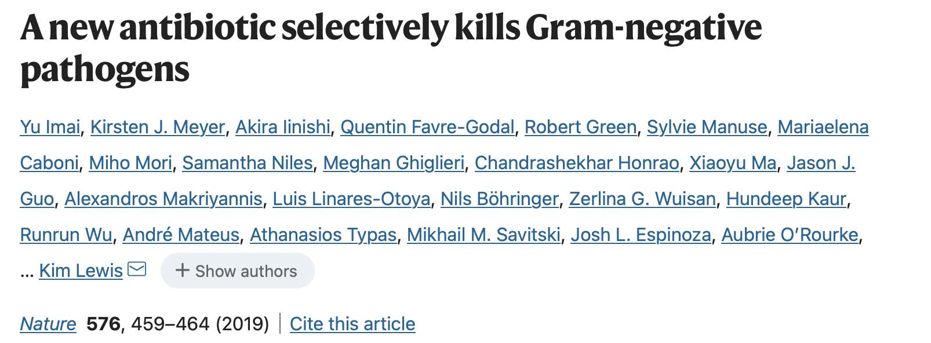
Discovery of a novel antibiotic by activating a silent operon
”poor expression of ‘silent’ biosynthetic gene clusters (BGCs) in vitro”
Notes:
Make specific case

Slide 3
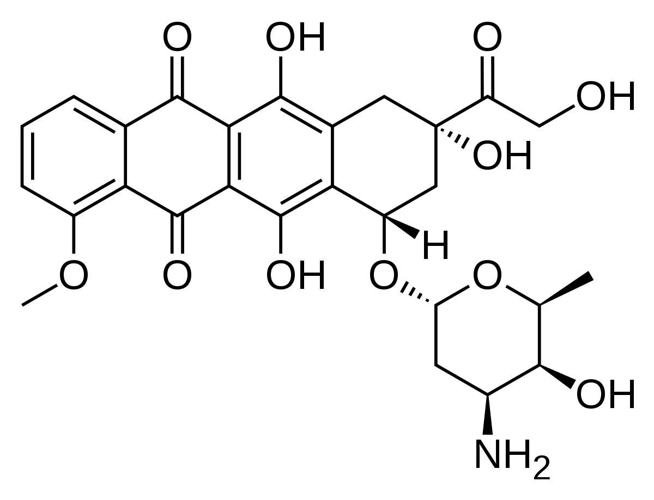
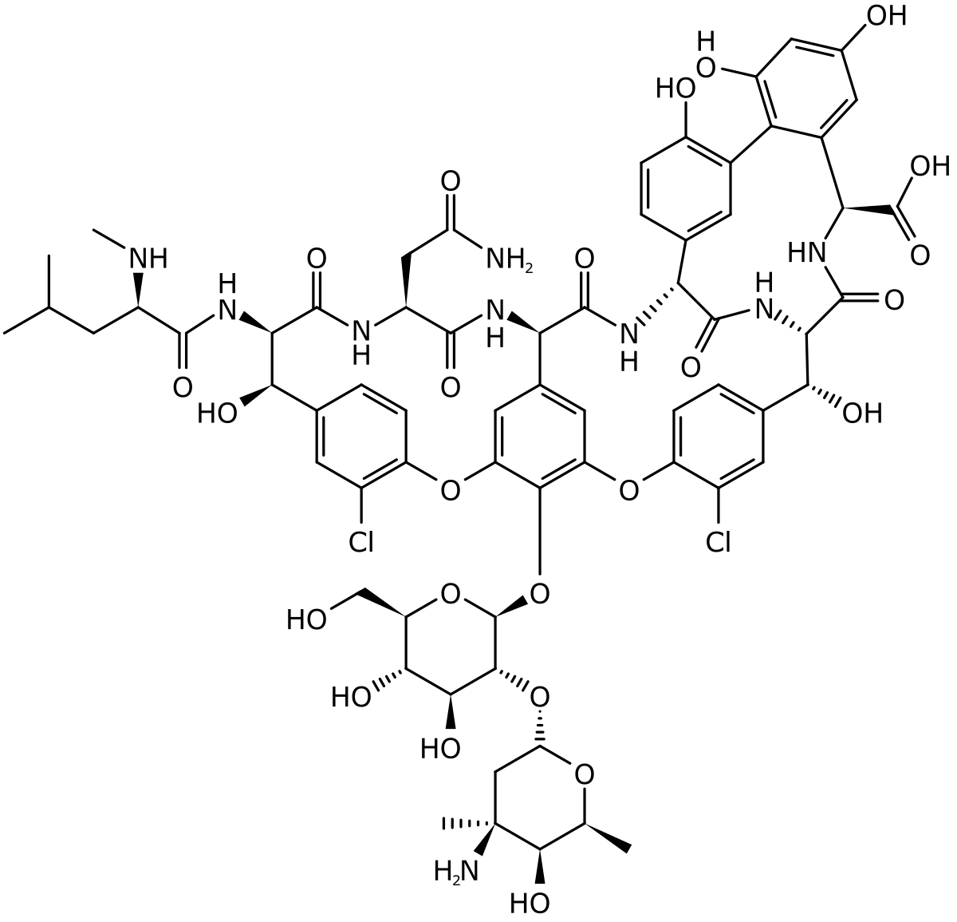
Our aim is to find the triggers that express BGCs
When are compounds produced?

Slide 4
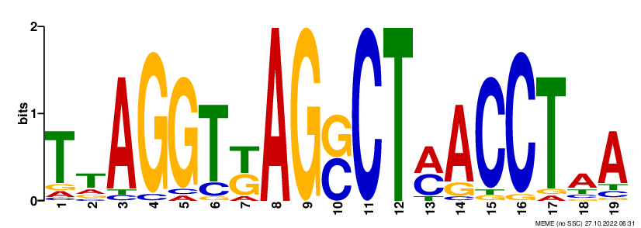
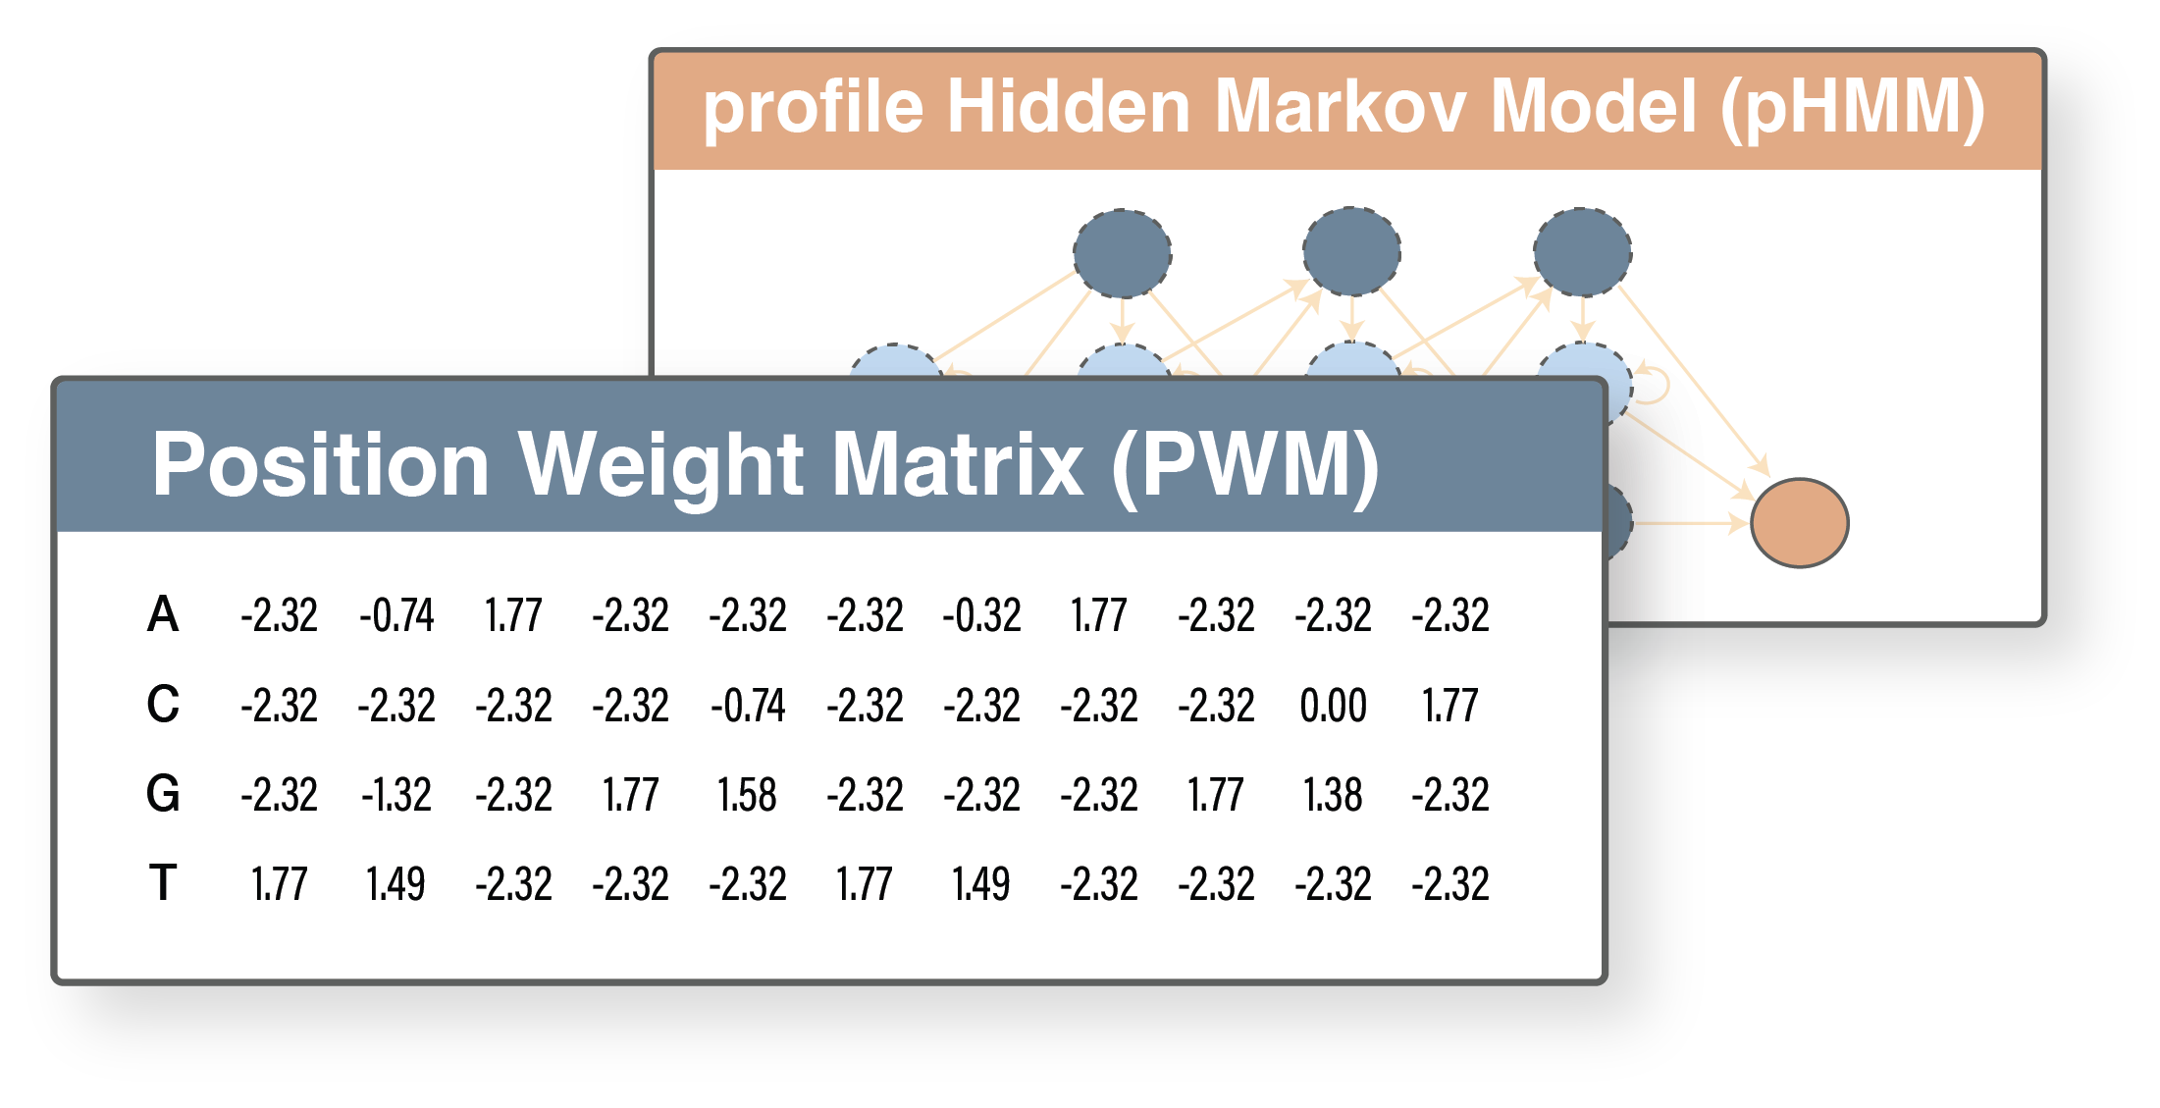
Regulatory networks to predict BGC function
!
Regulatory information:
Provides insights on BGC function
Gives clues on how to express BGCs
Helps prioritize BGCs
?
Transcription Factor Binding Site (TFBS)

Slide 5
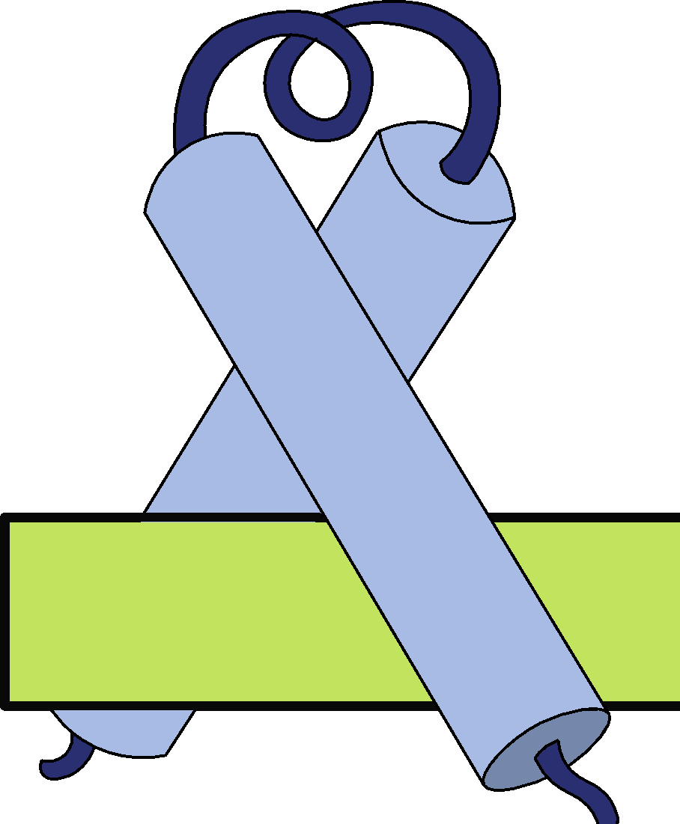
Repressor DmdR1 controls iron acquisition genes
In presence of iron
DmdR1 binding site
Siderophore genes
Low iron conditions
DmdR1 binding site
Siderophore genes

Slide 6
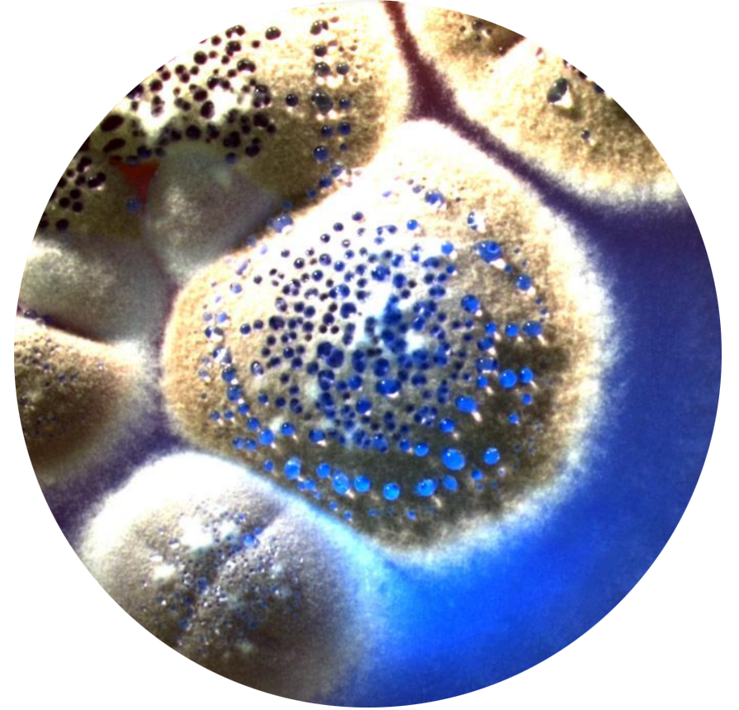
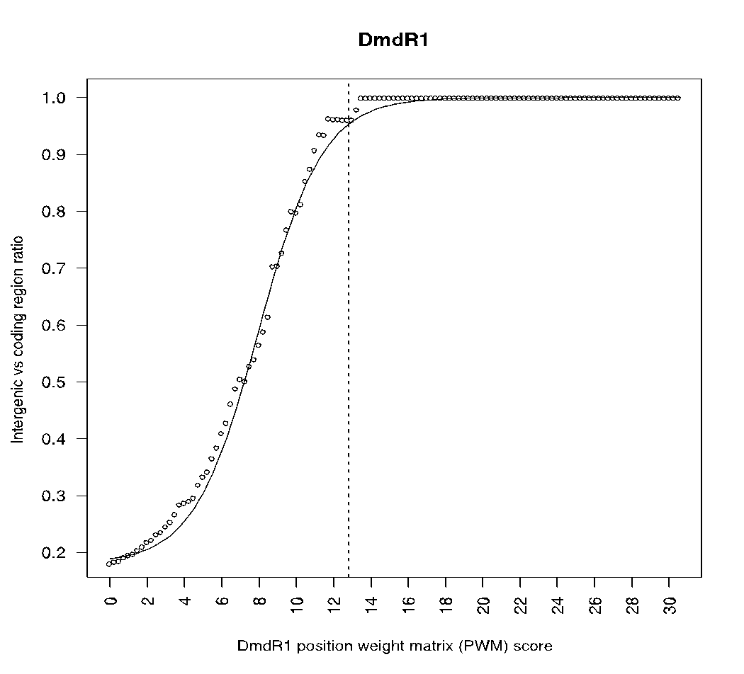
Detection of DmdR1 TFBSs in Streptomyces coelicolor
Are these hits in a larger operon?
Coding vs non-coding ratio
Streptomyces coelicolor
Position weight matrix (PWM) score
DmdR1 sequence logo

Slide 7
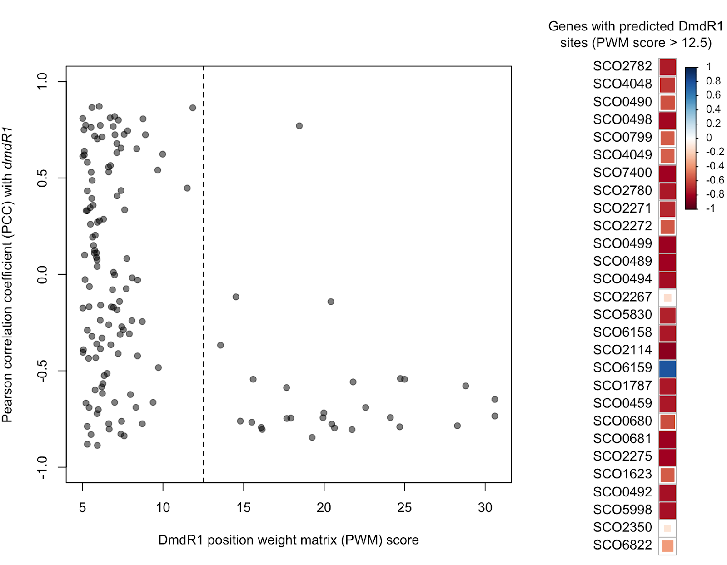
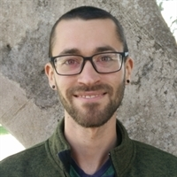
Anti-correlation of gene expression between dmdR1 and its predicted regulon
Pearson correlation coefficient (PCC)
Position weight matrix (PWM) score
Zach Reitz

Slide 8
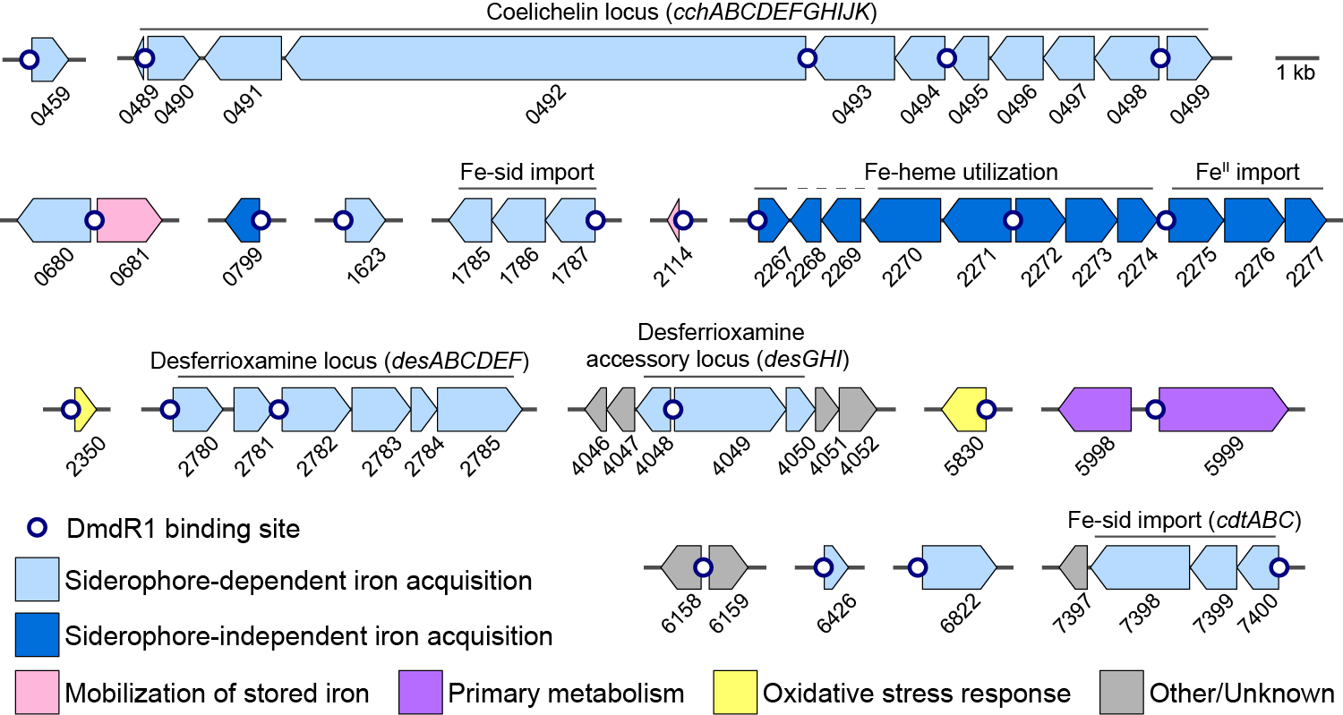
Regulatory networks in bacteria control the response to environmental changes

Slide 9
Desferrioxamine variants
SCO4046-4052 related to the desferrioxamine locus?
Cyclic
DFO E
R = Acetyl- or fatty acid-capped
Linear
DFO B
CRISPR-BEST: CRISPR-Base Editing SysTem
Le Zhang

Slide 10
Desferrioxamine variants
B
B
E
E
B
E
+Al
+Fe
+Al
+Fe
apo
apo
Cyclic
DFO E
R = Acetyl- or fatty acid-capped
Linear
DFO B
Notes:
Feature based molecular network: circle in the network represents consensus spectrum and the connected lines related fragmentation patterns

Slide 11
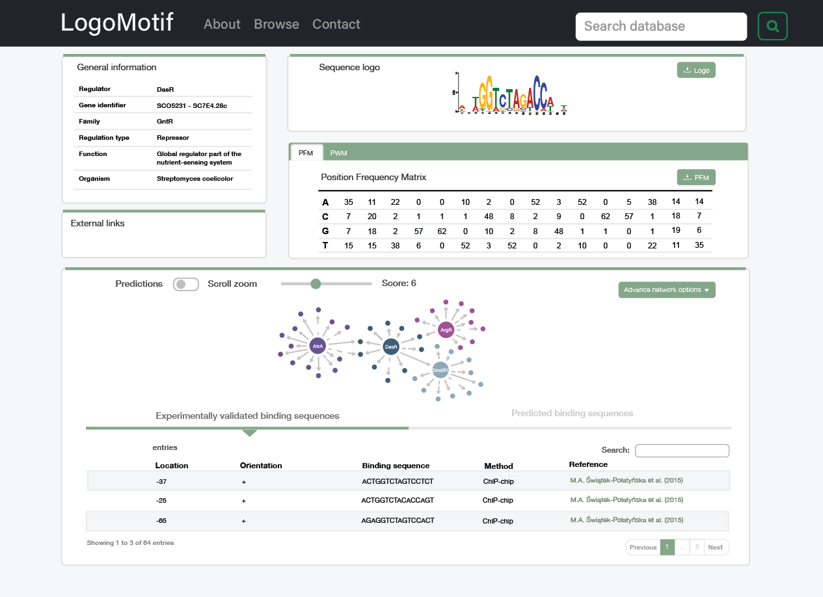
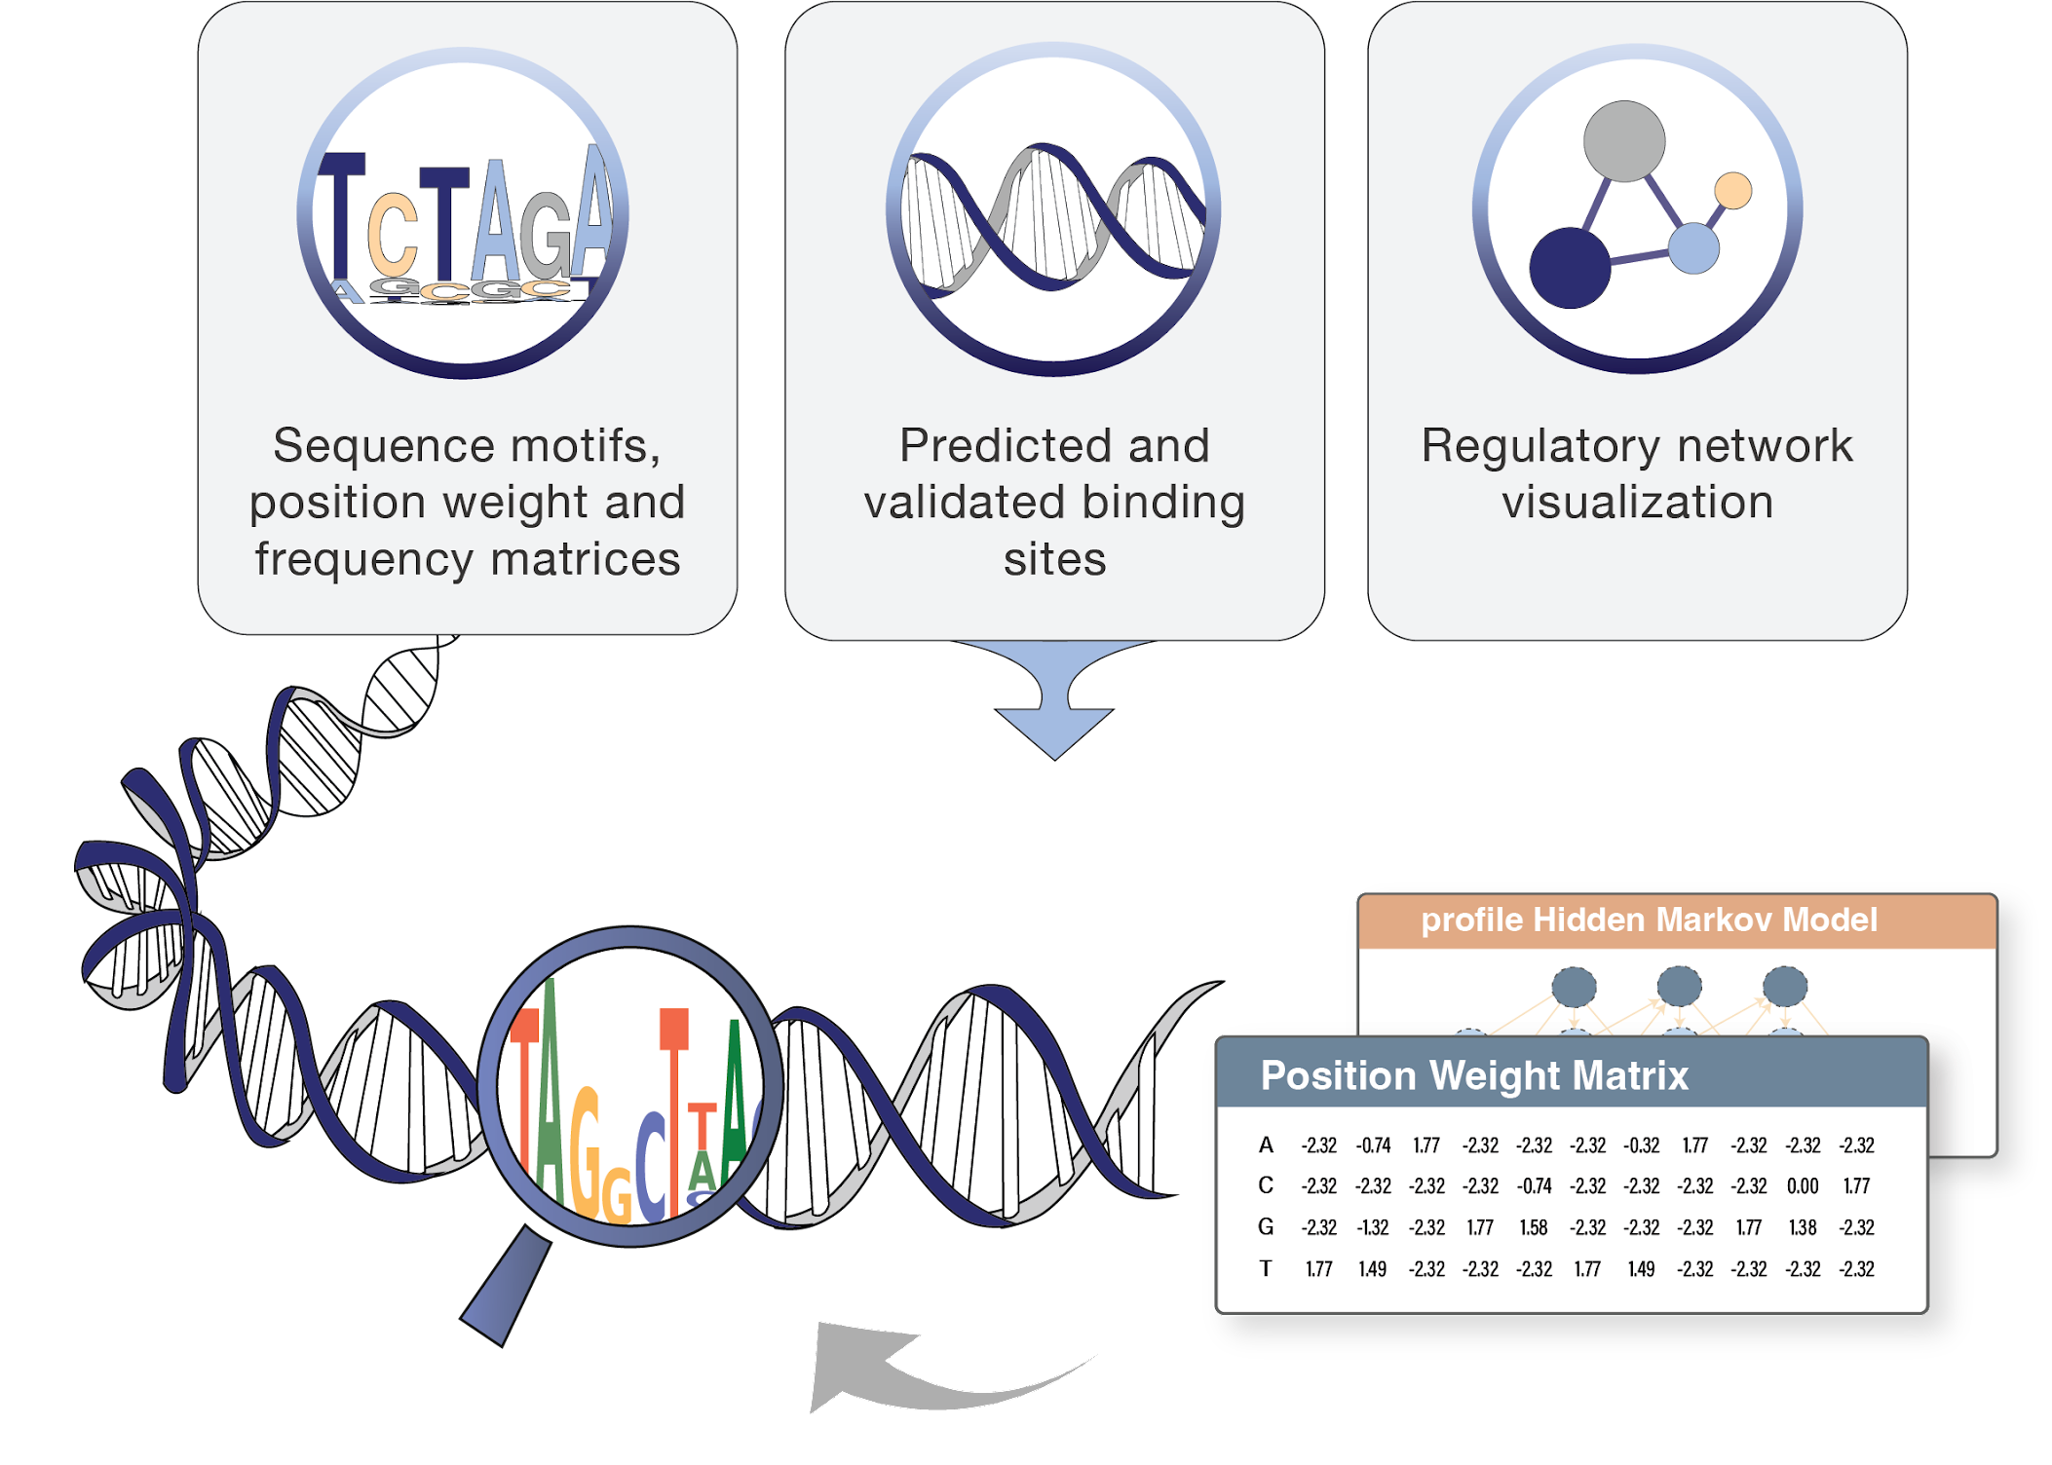
LogoMotif: a comprehensive database of TFBS profiles and regulatory networks in Actinobacteria
https://github.com/HAugustijn/MiniMotif/
https://logomotif.bioinformatics.nl

Slide 12
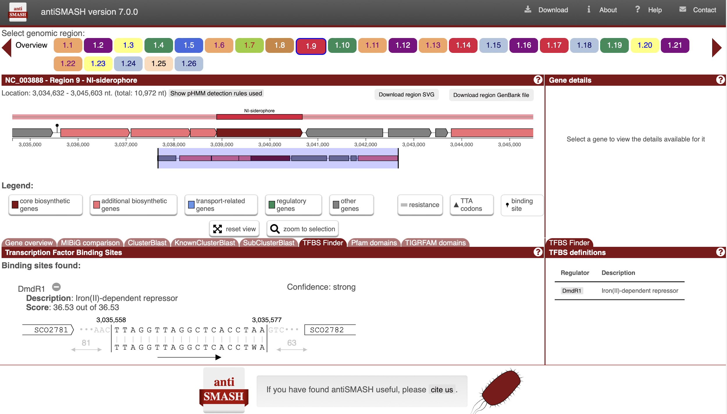
Binding site detection in antiSMASH v7 with the TFBS Finder

Slide 13
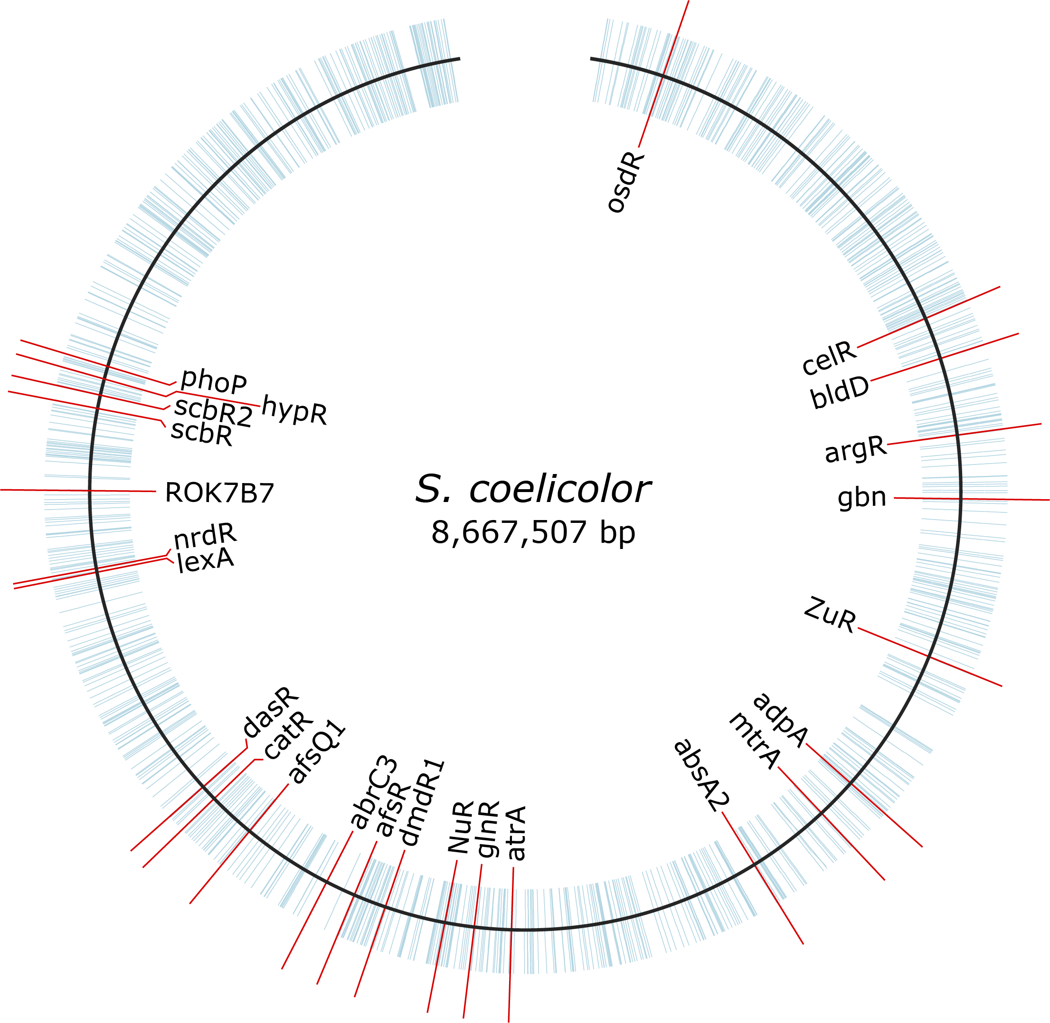
Expanding the regulatory network using DAP-seq & multiDAP
Analyzing >900 transcription factors across 10 different Actinobacteria
Expanding the regulatory network from 3% to 30%
Data will be made publicly available

Slide 14
Application of TFBS detection
Making TFBS detection easy to use
Future outlook: expanding the network
Novel BGC
LogoMotif
MultiDAP data
TFBS Finder
From 3% to 30%
Linear DFO
Expand TFBS detection beyond Actinobacteria

Slide 15
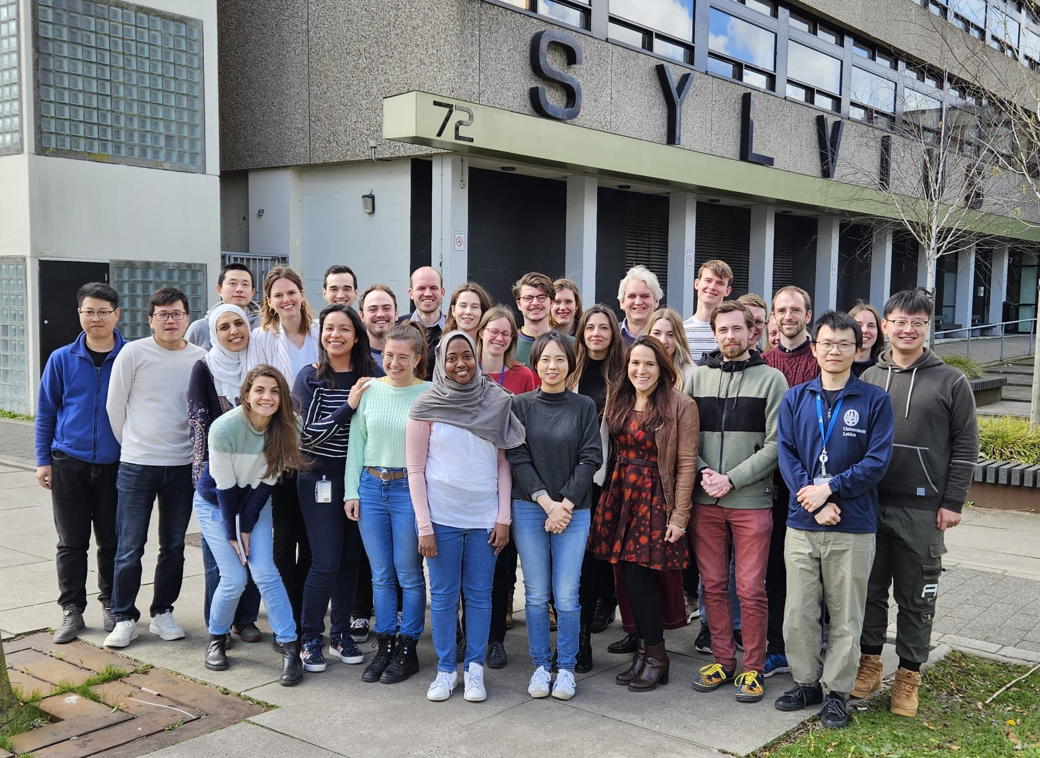
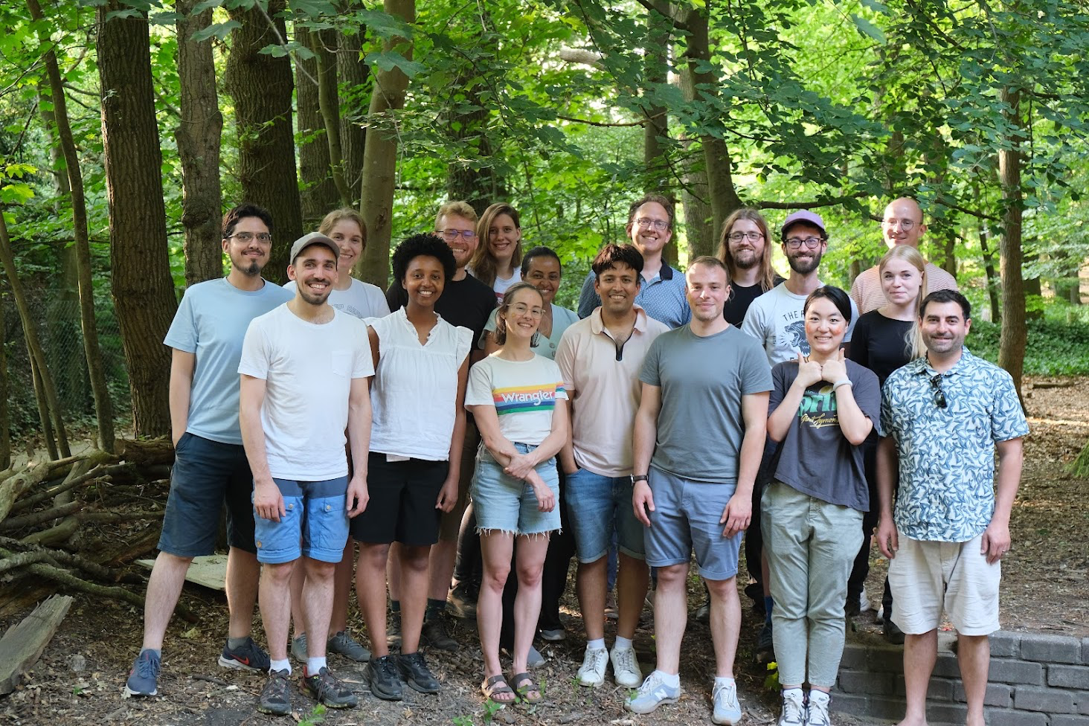
Acknowledgements
Wageningen University
Zach Reitz
Dimitris Karapliafis
Jeanine Boot
Kristy Joosten
Marnix Medema
Van Wezel lab
Leiden University
Le Zhang
Somayah Elsayed
Gilles van Wezel
Joint Genome Institute
Hiroshi Otani
Nigel Mouncey
Medema lab
Denmark Technical University
Simon Shaw
Kai Blin
Tilmann Weber

Slide 17
TFBS detection methods
pHMMs for gapped motifs
PWMs for ungapped motifs

